Slide 1
CARAP
FREPA
Awakening to languages - Workshop
22 Novembre 2012
Jean-François de Pietro - Ildikó Lőrincz
1

Slide 2
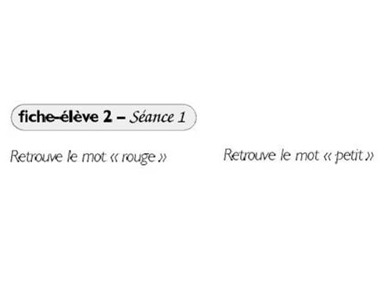
Research task : Title in Chinese
Colours
Size
Identifying,,locating, selecting
Find the word “red”
Find the word “little”

Slide 3
Quels constats?
3

Slide 4
K.5.3 Knows that there are many different kind of sript
K.11.3.4 Knows that cultural differences tend to dwindle under the influence of globalization
S.2.2.2 Can identify (recognize) a morpheme / a word in the written form of familiar or unfamiliar language
Relevant descriptors
4

Slide 5
• Awakening to languages
(also known as Language awareness):
Defined as an approach in which some of the learning activities are concerned with languages which the school does not intend to teach.
Of course not concerned exclusively with such languages : also language of schooling and any other language “learnt”. Integrates all sorts of other linguistic varieties – from the environment, home languages of pupils, … from all over the world…
5

Slide 6
• Awakening to languages
(also known as Language awareness):
Was designed principally as a way of welcoming schoolchildren into the world of linguistic diversity and the diversity of their own languages at the beginning of and during the school education …
Also as a driver towards fuller recognition of the languages “brought” into the school by allophonic children.
6

Slide 7
Communicative competence
Awakening to languages
20, 30 … L
Global metalinguistic abilities Receptiveness towards diversity
Notes:
2. approach

Slide 8
an interest in languages and cultures;
curiosity about these languages and cultures;
the learner's confidence in his or her own learning skills;
abilities in observing/analysing languages, regardless of the languages concerned;
development of positive representations and attitudes not just towards languages and their diversity but also towards those who speak the languages and their cultures
Awakening to languages contribute towards developing
8

Slide 9
Red Riding Hood
German, English, Breton, Chinese, Finnish, French, Hungarian, Icelandic, Italian, Polish, Portuguese, Russian.

Slide 10
Discovery of languages that are not familiar, focus on form of these languages, induction of « an attentive and reflexive disposition » to the language phenomena - awareness of the characteristics of the L1
Logic of by-pass
10

Slide 11
Les animaux en nombres
An activity about grammar (number) in several languages

Slide 12
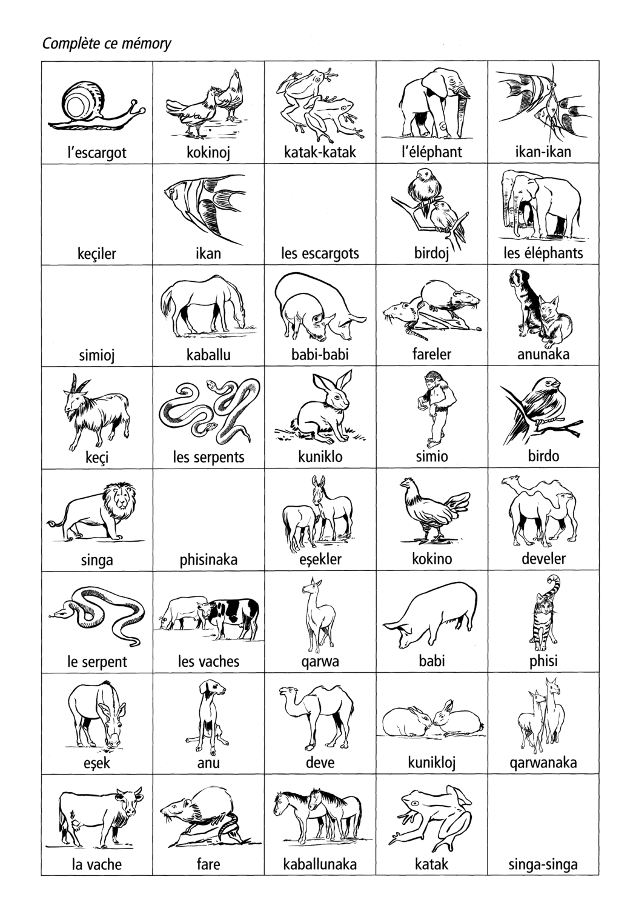
How to indicate the plural in these languages?...

Slide 13
Which descriptors?
Knowledge
K 6.1 Knows that each language has its own system
K 6.7.1 Knows that languages may use different ways to indicate °categories / relations° {agreement / plural / possession...}

Slide 14
2. Attitudes
A 2.2 Sensitivity to °linguistic / cultural° differences
A 2.2.1 Being aware of different aspects of °language / culture° which may vary °from language to language / from culture to culture°
A 3.2 Curiosity about discovering how (one’s own / other) °language(s) / culture(s)° work(s)
A 4 Positive acceptance °°of °linguistic / cultural° diversity / of others / of what is different°°
A 4.2 Accepting the fact that another °language / culture° may function differently from one’s °language / culture°

Slide 15
2. Attitudes
A 7.5.1 Motivation for the observation and analysis of more or less unfamiliar °linguistic / cultural° phenomena
A 11.1 °°Being disposed to distance oneself from one’s own °language / culture° // look at one’s own language from the outside°°
A 12.3 Disposition to go beyond evidence developed in relation with the mother °language / culture° in order to comprehend °languages / cultures°, whichever these may be
A 12.4 Disposition to reflect on the differences between °languages / cultures° and on the relative nature of one’s own °linguistic / cultural° system

Slide 16
Skills
S 1.4 Can °observe / analyse° syntactic and/or morphological structures
S 1.4.1 Can divide compound words into their constituent words
S 2.4 Can °identify [recognise]° grammatical °categories / functions / markers° {article, possessive, gender, time, plural…}
S 3 Can compare °linguistic / cultural° features of different °languages / cultures° [Can °perceive / establish° °linguistic / cultural° proximity and Distance]

Slide 17
The aim is to give pupils a positive attitude to language and cultural diversity (including minority, immigrant and regional languages)
to help them develop metalinguisitc skills which they can then apply to language learning (at school and outside)
include a several unknown languages
Particulary adapted to receiving migrant (allophonic) children in the classroom
Conclusion: What is the approache „awakening to languages” ?
17

Slide 18
18

