Slide 1
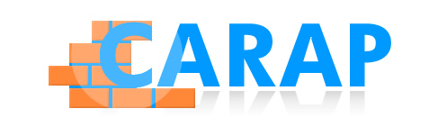
Michel Candelier
Université du Maine
FREPA – A complement for the CEFR?

Slide 2
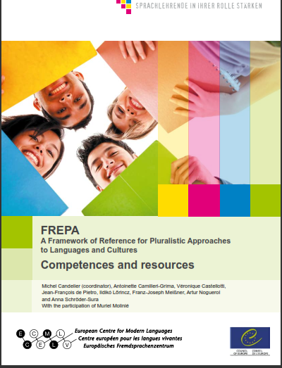
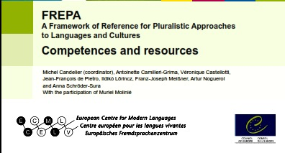
What is FREPA?
FREPA instruments and principles
Possible links to the CEFR
Examples of cooperation with member states and other ECML projects

Slide 3
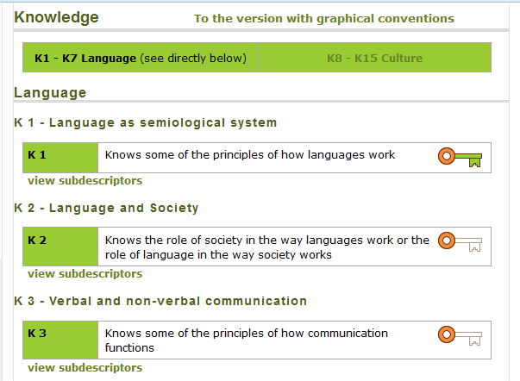
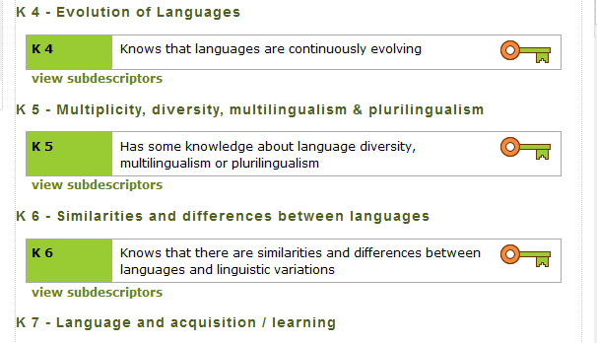
http://carap.ecml.at/

Slide 4
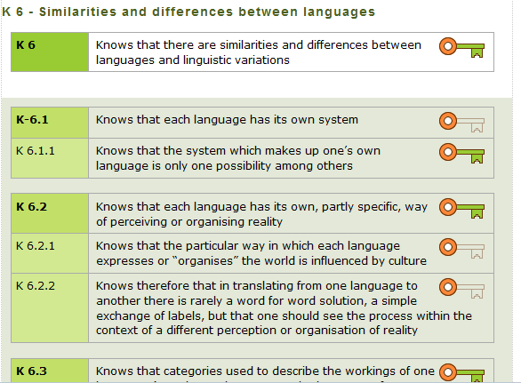
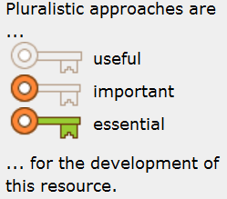
http://carap.ecml.at/

Slide 5
http://carap.ecml.at/

Slide 6
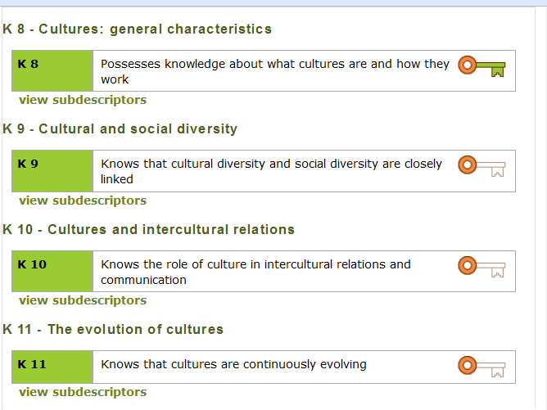

Slide 7
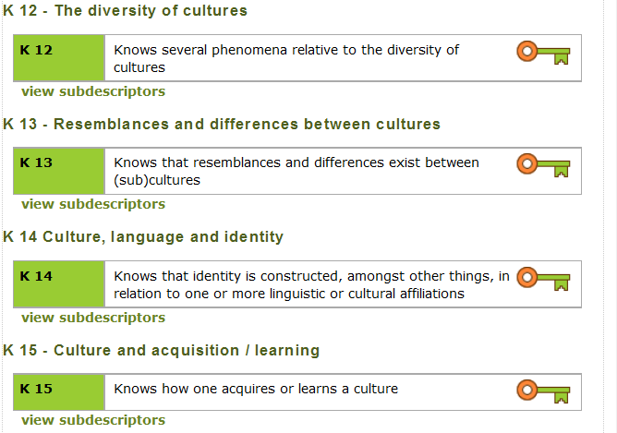

Slide 8

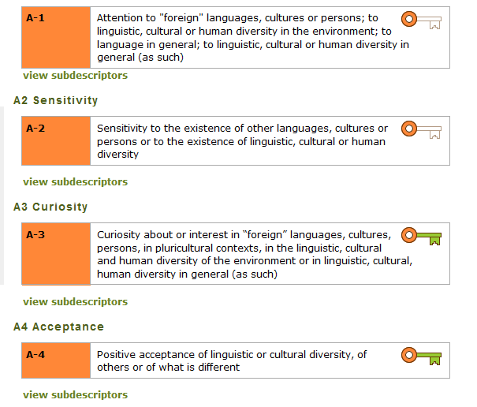


Slide 9
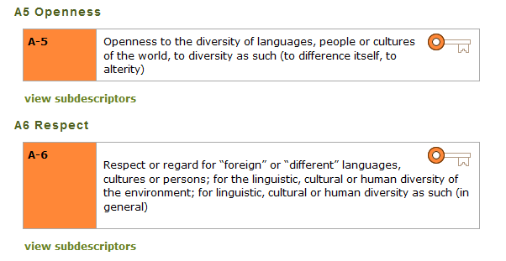
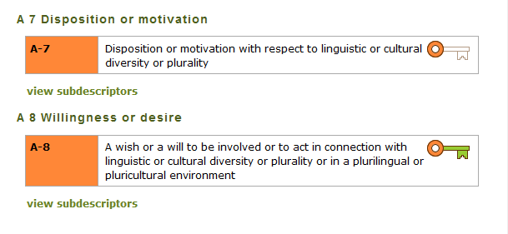

Slide 10
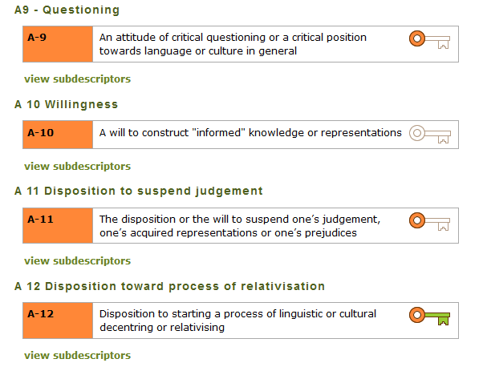

Slide 11
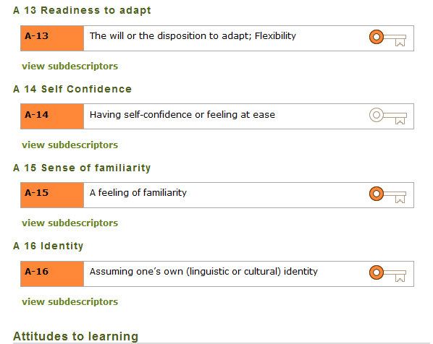

Slide 12
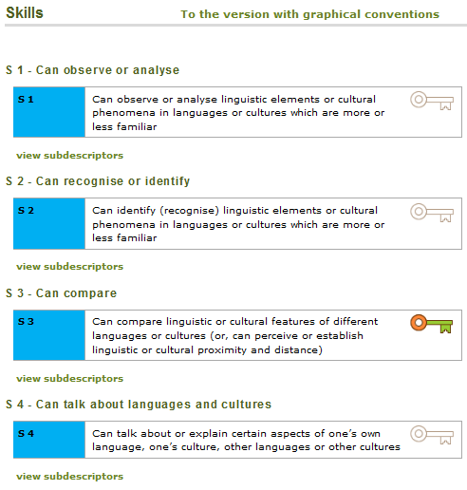

Slide 13
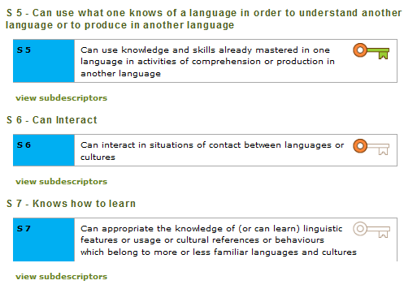


Slide 14
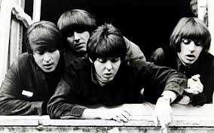
Where do they all come from?

Slide 15
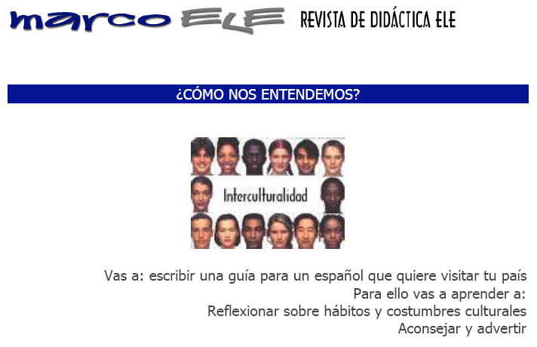
What are pluralistic approaches?
Definition:
The concept of pluralistic approaches refers to didactic approaches which use learning/teaching activities involving several (i.e. more than one) varieties of language or culture.
"You will write a guide for a Spaniard who would like to visit your country.
For this, you will learn how to :
- reflect on cultural habits and customs
- advise and warn."
Intercultural approach(es)
Michel Candelier - CEFR Web Conference - 28-29 March 2014
15

Slide 16
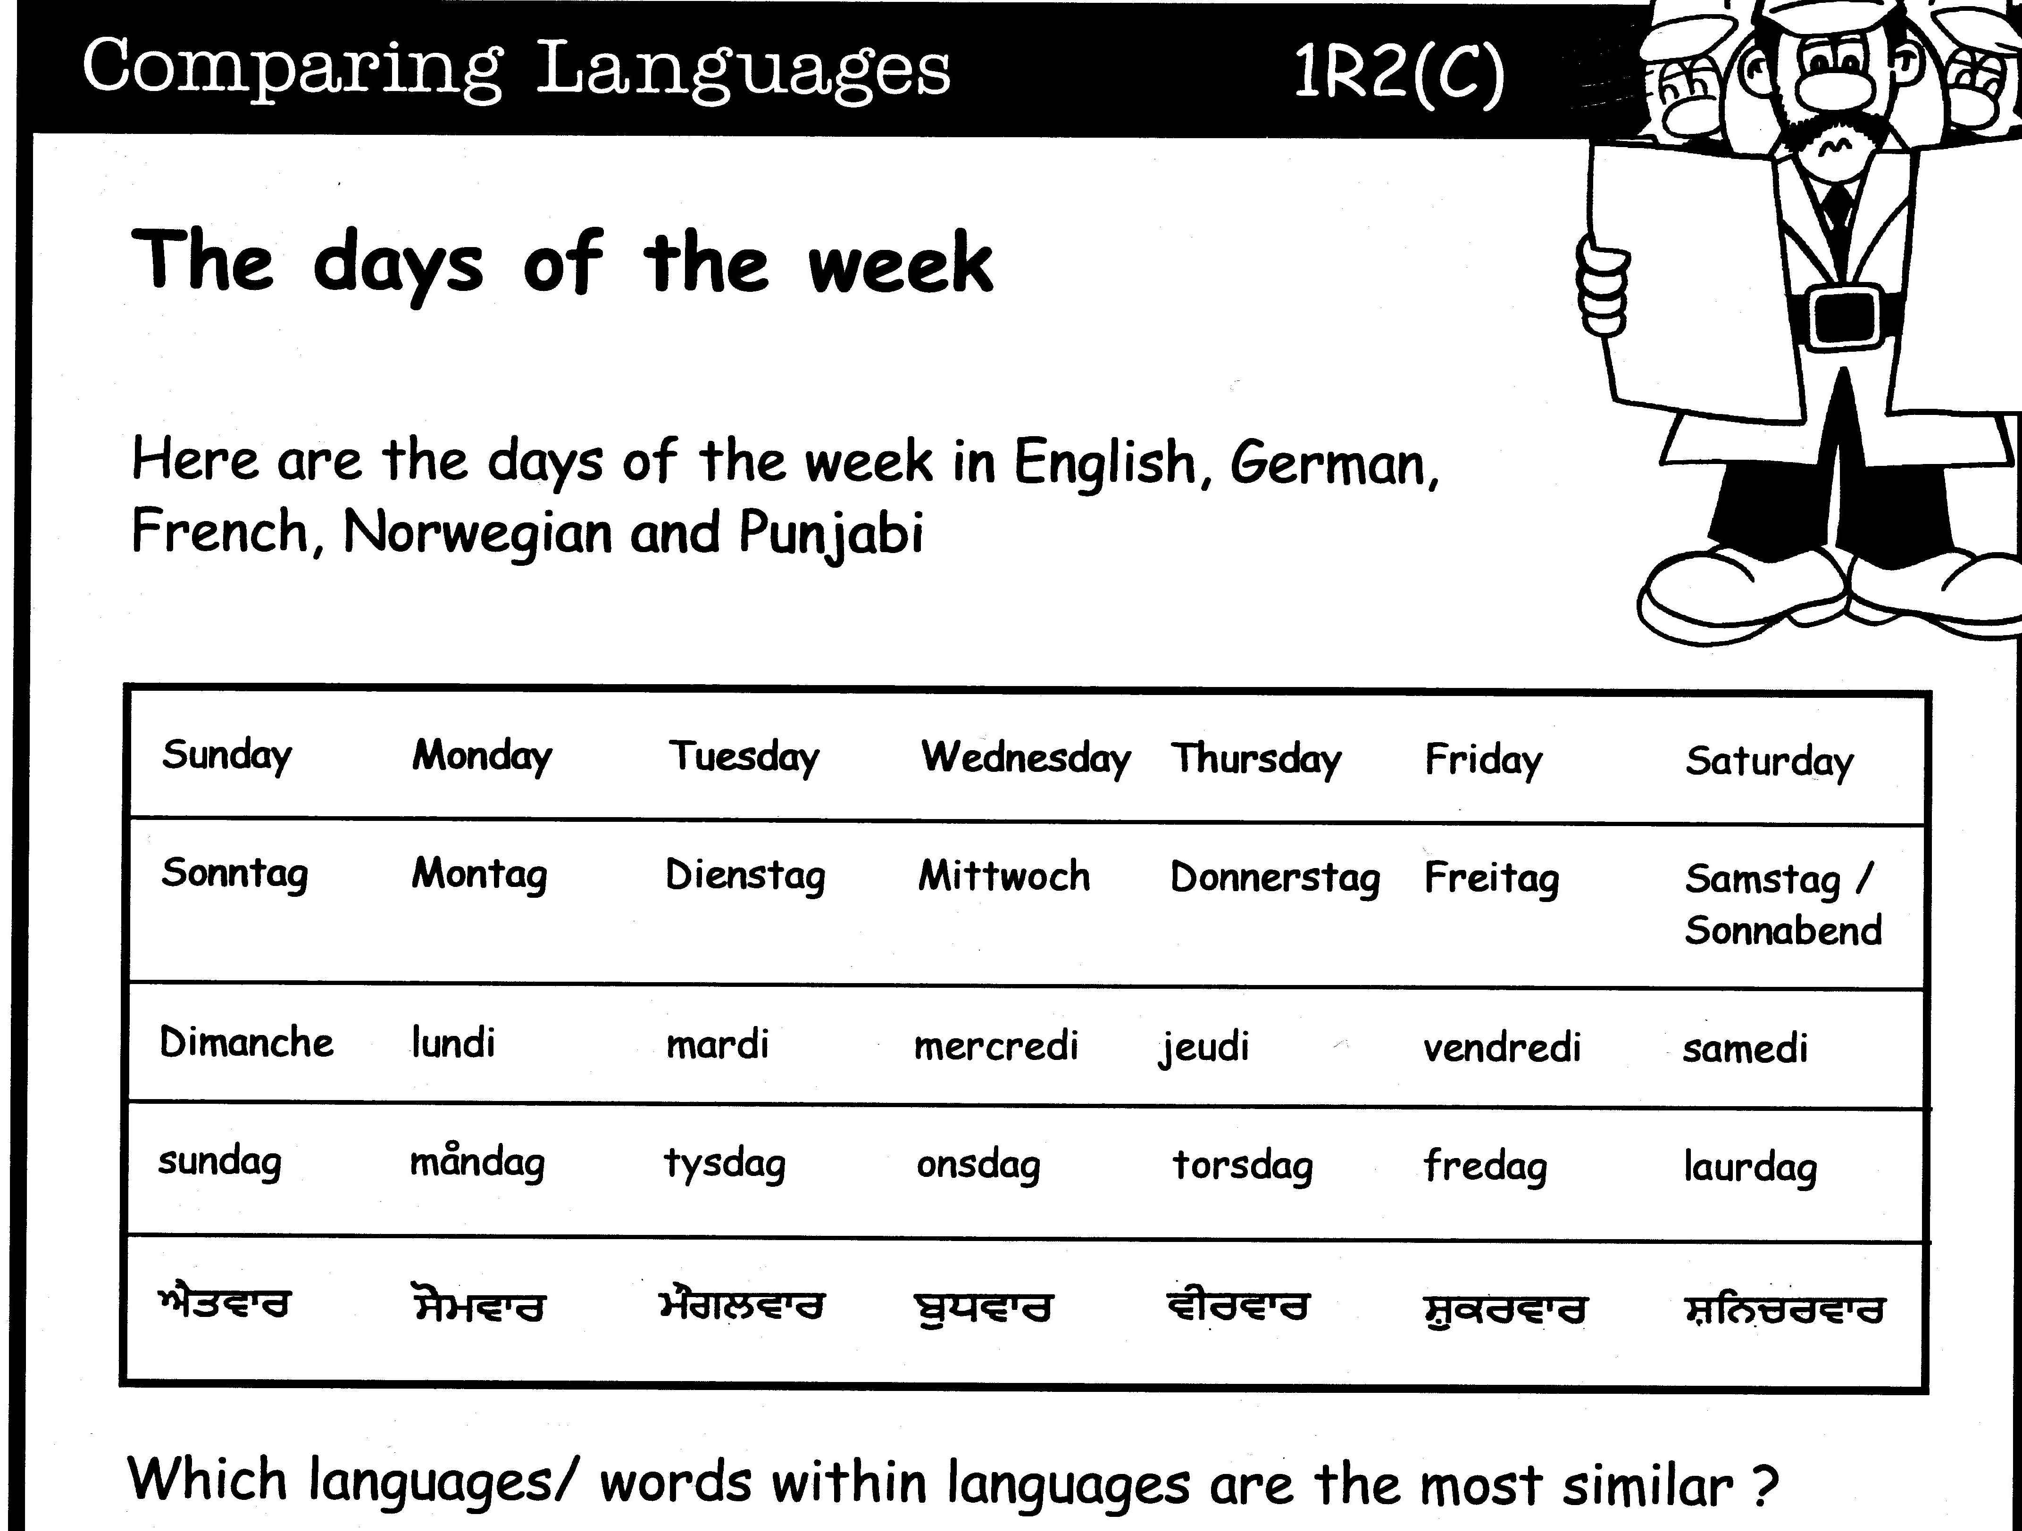
What are pluralistic approaches?
What are pluralistic approaches?
Definition:
The concept of pluralistic approaches refers to didactic approaches which use learning/teaching activities involving several (i.e. more than one) varieties of language or cultures.
Definition:
The concept of pluralistic approaches refers to didactic approaches which use learning/teaching activities involving several (i.e. more than one) varieties of language or cultures.
From: Thinking
through
languages
Coventry
City
Council
Awakening to languages (Language Awareness)
Michel Candelier - CEFR Web Conference - 28-29 March 2014
16

Slide 17
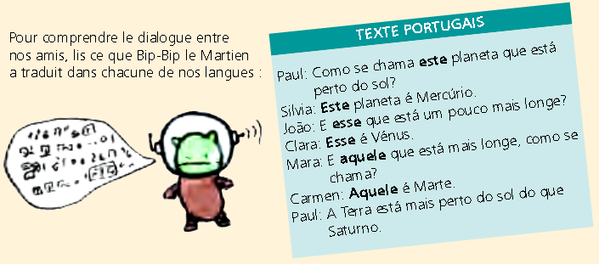
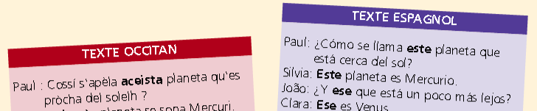
What are pluralistic approaches?
Definition:
The concept of pluralistic approaches refers to didactic approaches which use learning/teaching activities involving several (i.e. more than one) varieties of language or cultures.
"In order to understand what our friends have said, you should read what Bip-bip the Martian has translated into each of our languages."
From: Euromania
Intercomprehension
Michel Candelier - CEFR Web Conference - 28-29 March 2014
17

Slide 18
What are pluralistic approaches?
Definition:
The concept of pluralistic approaches refers to didactic approaches which use learning/teaching activities involving several (i.e. more than one) varieties of language or cultures.
English German Your mother tongue
From: Kursiša, A. & Neuner, G. (2006). Deutsch ist easy
Integrated didactic approach
Michel Candelier - CEFR Web Conference - 28-29 March 2014
18

Slide 19

Where do they all come from?
Integrated didactic approach
Awakening to languages
Intercultural approach(es)
Intercomprehension
Michel Candelier - CEFR Web Conference - 28-29 March 2014
19

Slide 20
Competences /vs./ resources?
Competences:
- complexity
- socially relevant tasks
- context
Resources:
- internal
. Knowledge
. Attitudes
. Skills
- external
Ability to select the right resources

Slide 21
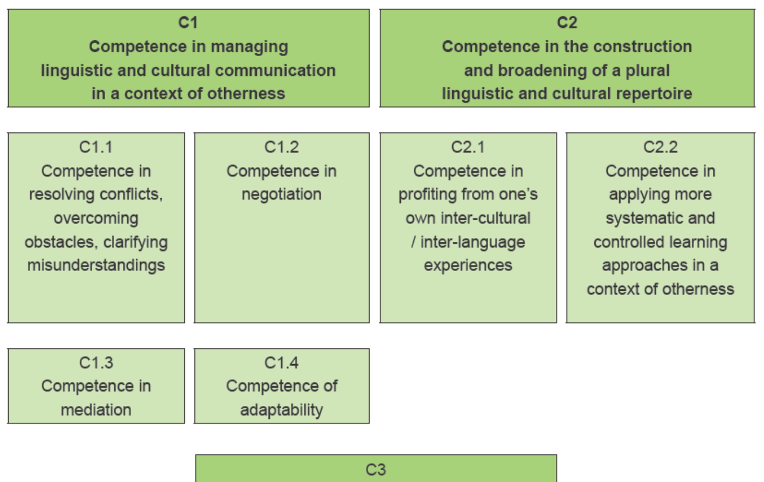


FREPA – Table of competences
Michel Candelier - CEFR Web Conference - 28-29 March 2014
21
21

Slide 22
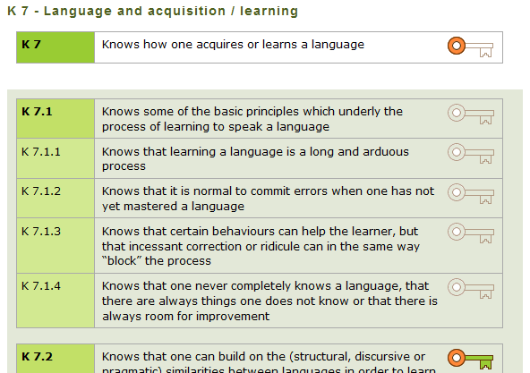
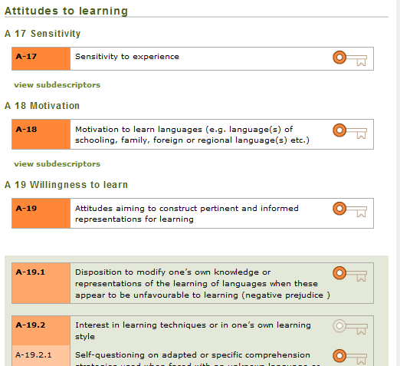
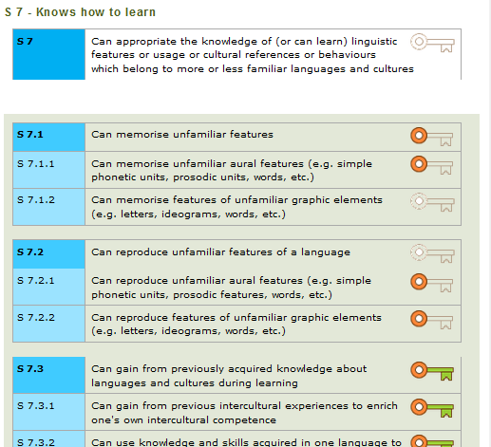
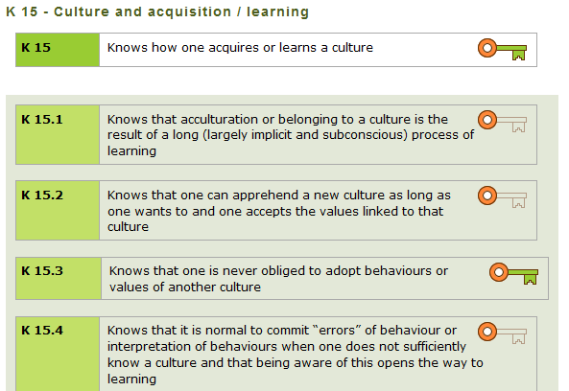

Slide 23
Examples of descriptors related to the
Language learning competence
L.
L
E
A
R
N.
C
O
M
P
E
T
E
N
C
E
Knows that one can rely on the (structural / discursive / pragmatic) similarities between languages in order to learn languages
Knowledge
Attitudes
Confidence in one’s capacities °of observation / of analysis° of little known or unknown languages
Skills
Can gain from previously acquired knowledge about languages and cultures during learning
23
Notes:
23

Slide 24
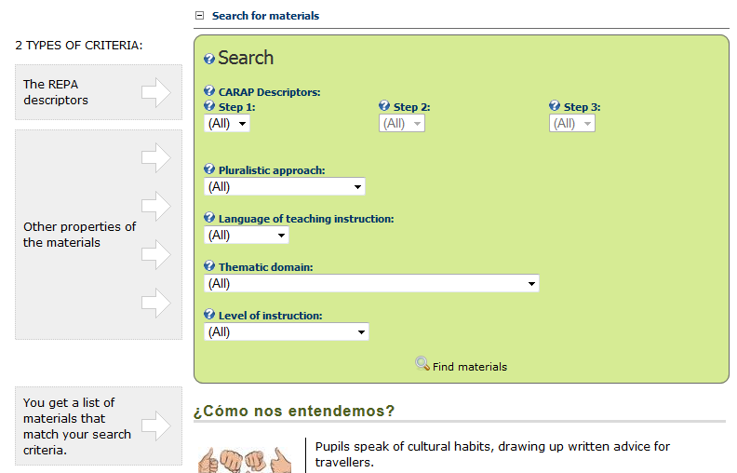
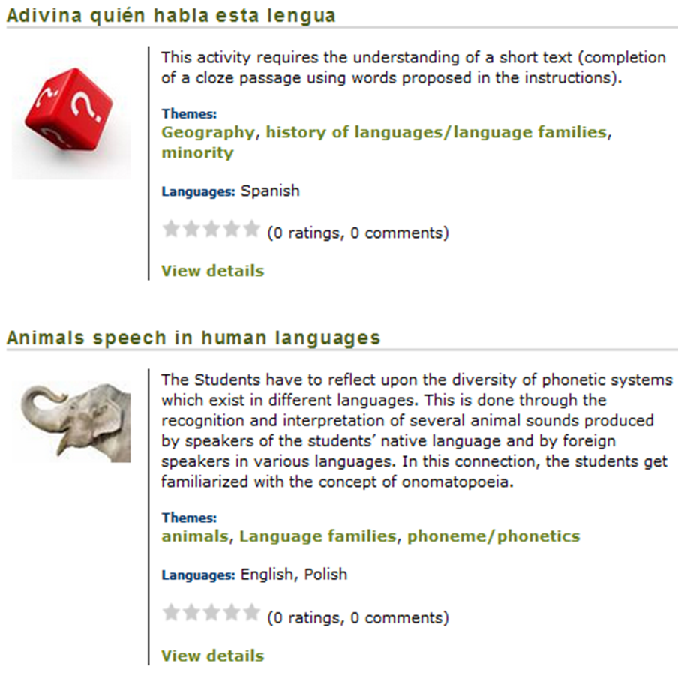
FREPA – Online teaching materials
SELECTION
MATERIALS + DOWNLOAD
Michel Candelier - CEFR Web Conference - 28-29 March 2014
24
24

Slide 25
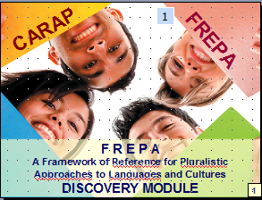
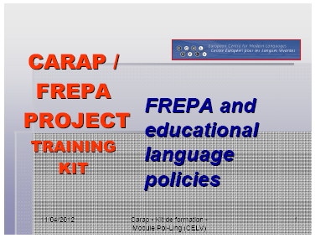
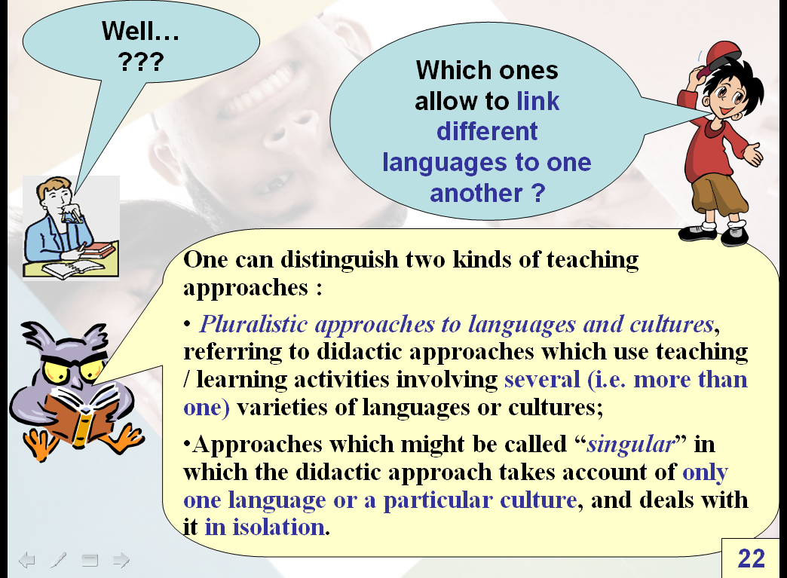
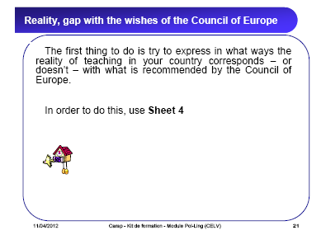
FREPA – A training kit
Michel Candelier - CEFR Web Conference - 28-29 March 2014
25

Slide 26
FREPA as a complement
to the CEFR

Slide 27
Plurilingual and pluricultural competence
and
Pluralistic approaches
CEFR
Chapter 8
… encompassing the full range of languages available to him/her
CEFR –
Chapter 8
… deal with more than one language simultaneously
Guide
2003/7
… not dealt with in isolation … treated as a single competence

Slide 28
The contribution of FREPA
to complementing the CEFR
In which domains?
Sets of descriptors for plurilingual and intercultural competences
For a tool helping to develop language learning competences
Basis for a reference tool for teachers’ competences

Slide 29
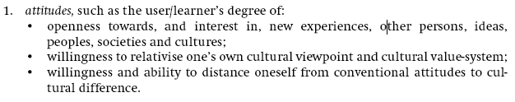
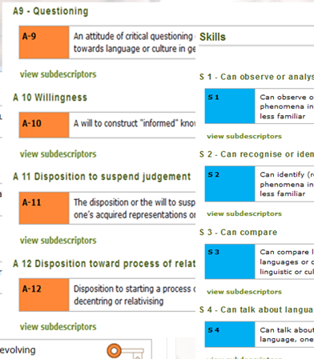
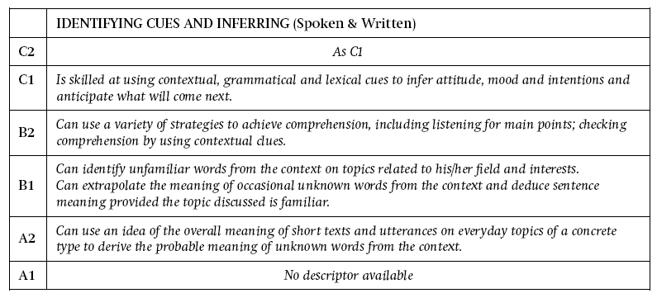
First empirical steps :
Which elements of the CEFR can be linked
to FREPA descriptors ?
FREPA
DESCRIPTORS
Michel Candelier - CEFR Web Conference - 28-29 March 2014
29

Slide 30
Disseminating pluralistic approaches and FREPA: Experiences and reflections
Michel Candelier - CEFR Web Conference - 28-29 March 2014
30

Slide 31
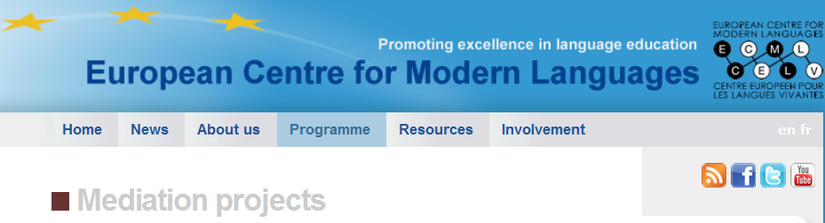
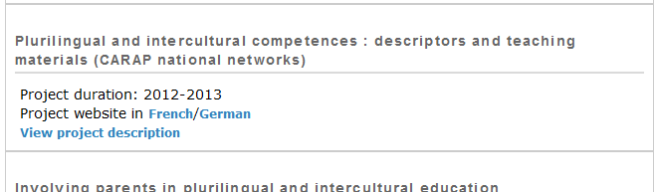
Training events in Armenia, Croatia, Lithuania,
Malta, Poland.
17 country pages, in the language(s) of the country.
…
Michel Candelier - CEFR Web Conference - 28-29 March 2014
31

Slide 32
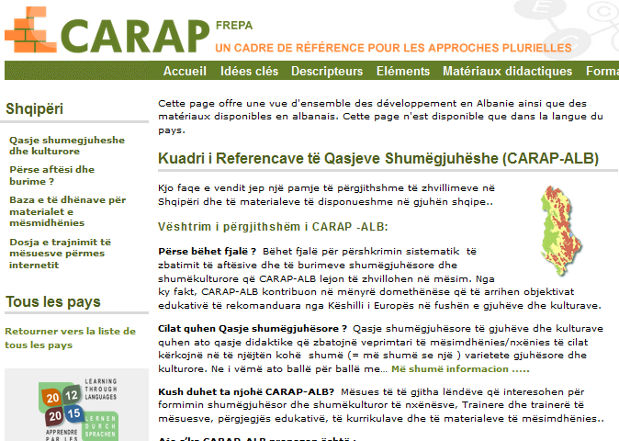
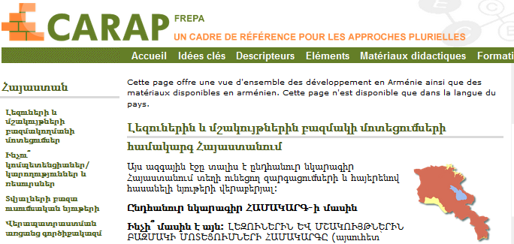
Training events in Armenia, Croatia, Lithuania,
Malta, Poland
17 country pages, in the language(s) of the country.
…
Michel Candelier - CEFR Web Conference - 28-29 March 2014
32

Slide 33
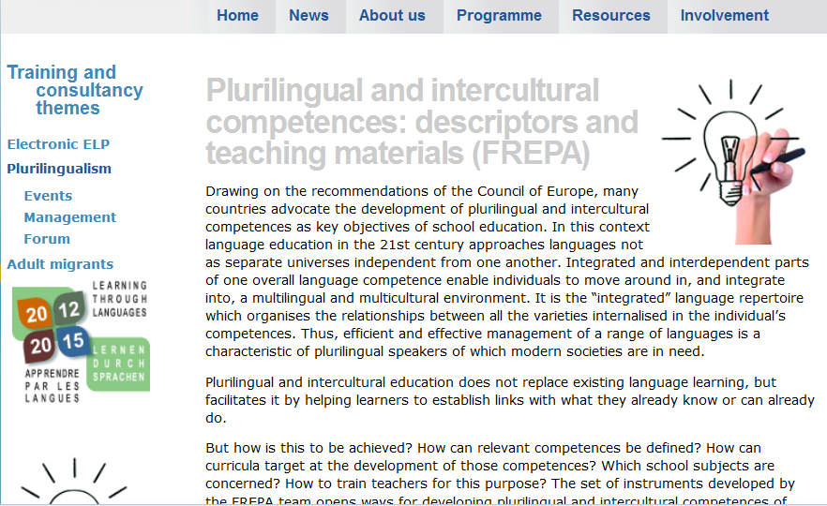
2014: 8 countries : Armenia, Finland, France, Germany, Malta, Poland, Slovenia, Slovakia
2013: Iceland.
Michel Candelier - CEFR Web Conference - 28-29 March 2014
33

Slide 34

European Portfolio for Student Teachers of Languages (EPOSTL)
“Crossing continents: EPOSTL around the world”
Describing language teacher competences with FREPA-descriptors? – Preliminary thoughts
Graz, 18 – 19 February 2014
1- Subdividing the EPOSTL competences wtih reference to FREPA descriptors?
2- Adding competences to some sections?
Anna Schröder-Sura
anna.schroeder-sura@romanistik.uni-giessen.de
Justus-Liebig-Universität Gießen, Germany
FREPA Team member, ECML, Graz
3- Adding a new categorie „Plurilingual and intercultural education“?
Michel Candelier - CEFR Web Conference - 28-29 March 2014
34
Notes:
34

Slide 35

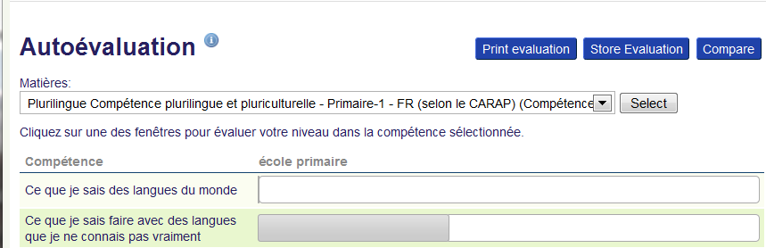
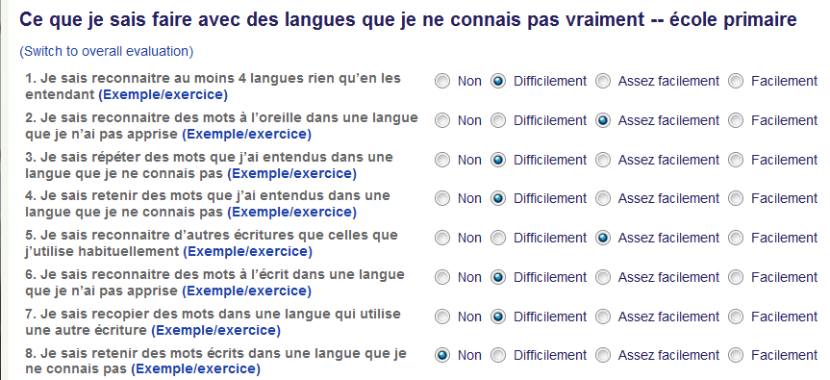
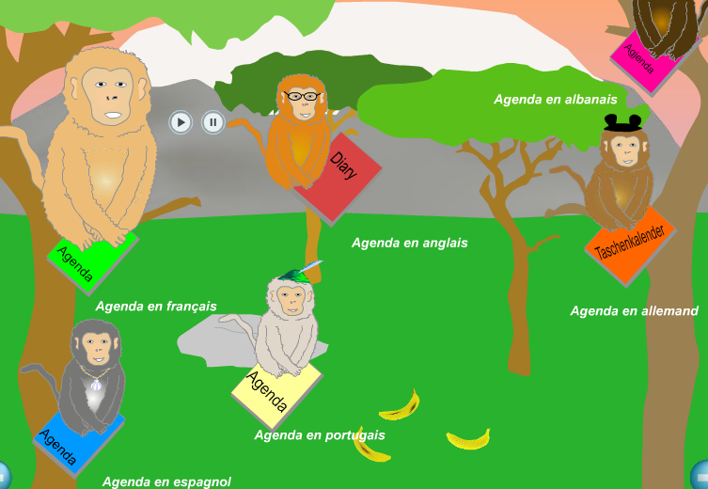
FREPA descriptors | Descriptors for Théo (7-8 year old learner)
S 2.5.1 Can identify languages on the basis of phonological evidence | 1. I can recognise at least four languages while listening
S 2.1.3 Can identify (or recognise) a morpheme or a word while listening | 2. I can recognise words in a language that I havent’t learnt while listening
Michel Candelier - CEFR Web Conference - 28-29 March 2014
35
35

Slide 36
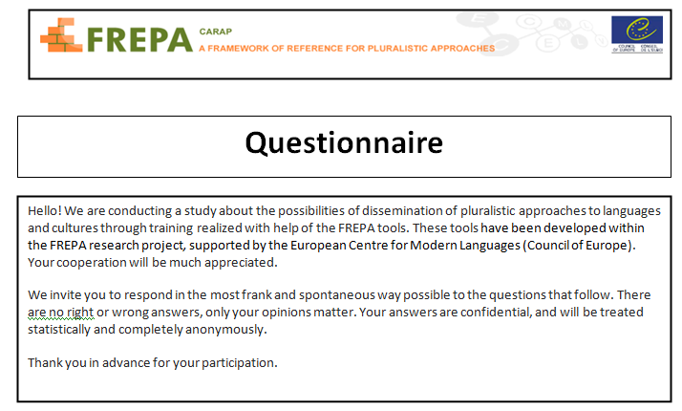
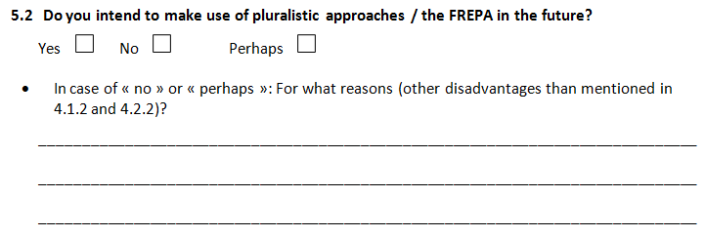
36

Slide 37

dank u wel
gmadlobth
obrigado
спасибо
tanemirt
Ευχαριστώ
enkosi
kiitos
misaotra
Notes:
37

