Slide 1
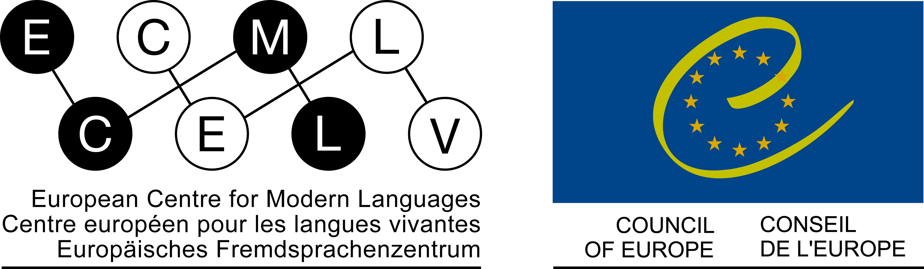


Petra
Daryai-Hansen
Michel Candelier
Roskilde Universitet
Le Mans
PLURALISTIC APPROACHES AND FREPA AS TOOLS FOR LANGUAGE AND INTERCULTURAL EDUCATION

Slide 2
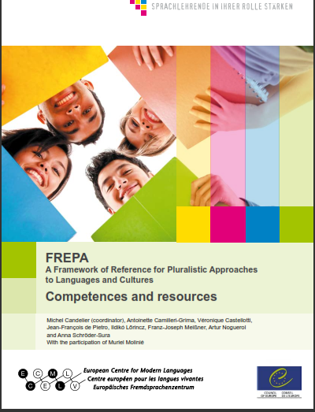
What is FREPA?
FREPA instruments and principles
The link between FREPA and so called « Pluralistic approaches »
The origin of FREPA
The current dissemination of FREPA
Possible links to the CEFR

Slide 3
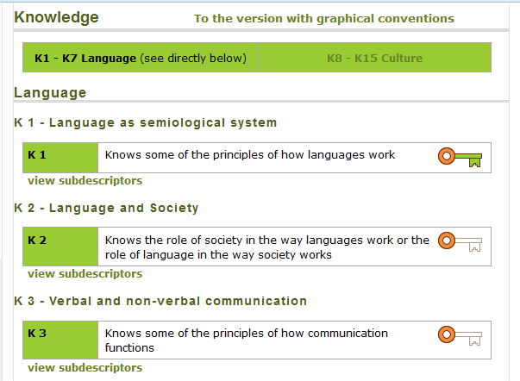
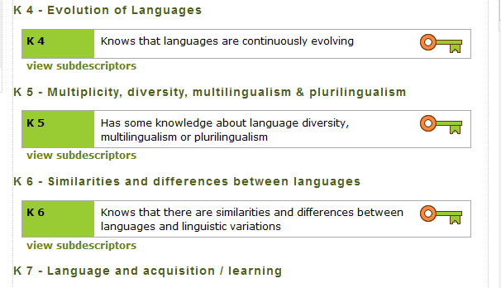
http://carap.ecml.at/
3

Slide 4
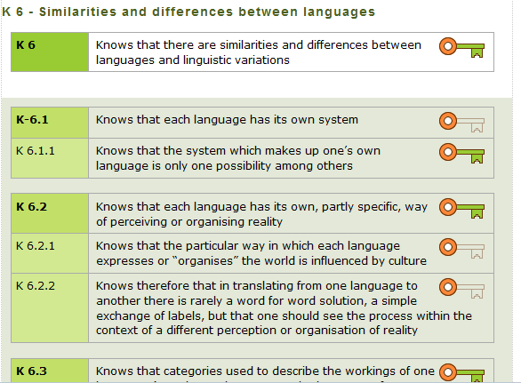
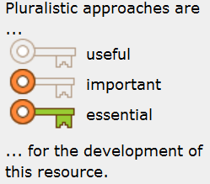
http://carap.ecml.at/
4

Slide 5
http://carap.ecml.at/
5

Slide 6
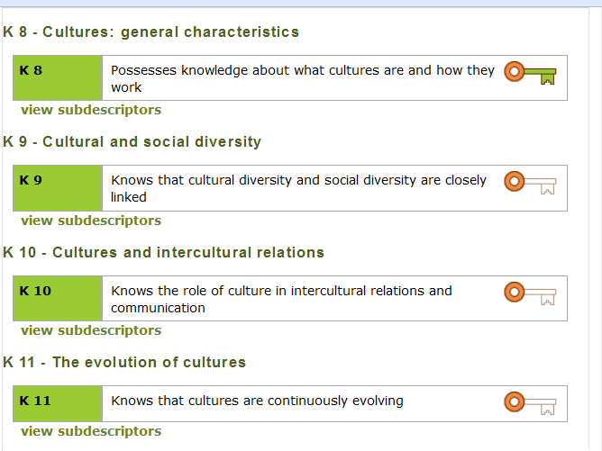

Slide 7
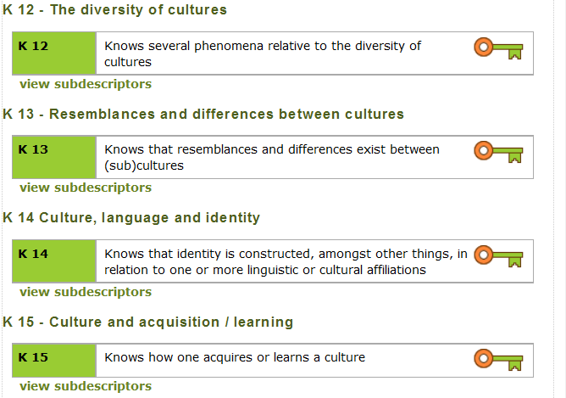

Slide 8

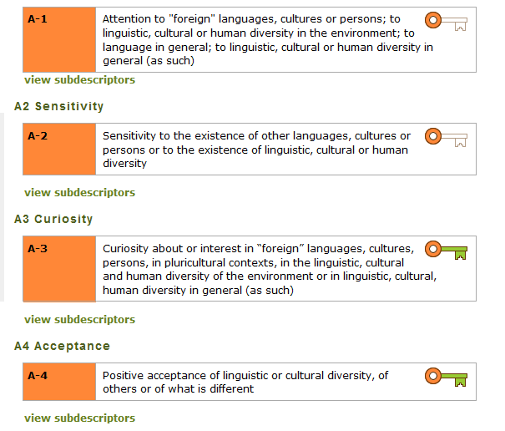


Slide 9
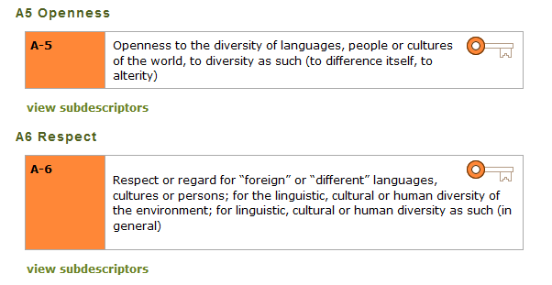
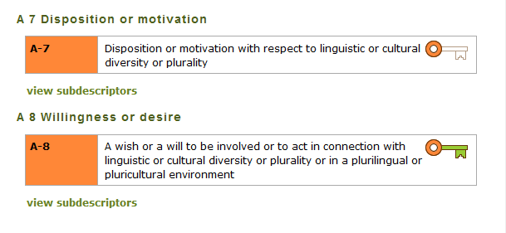

Slide 10
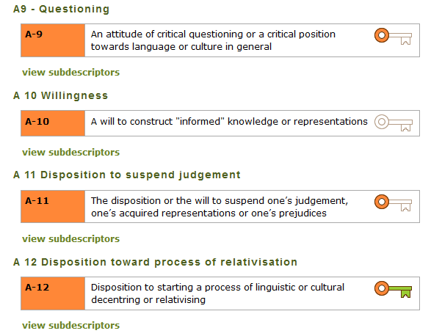

Slide 11
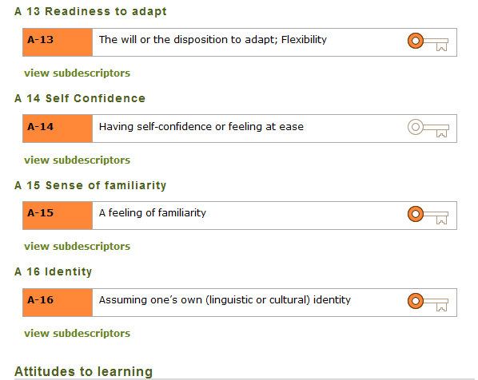

Slide 12
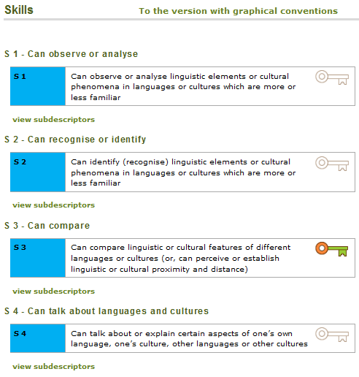

Slide 13
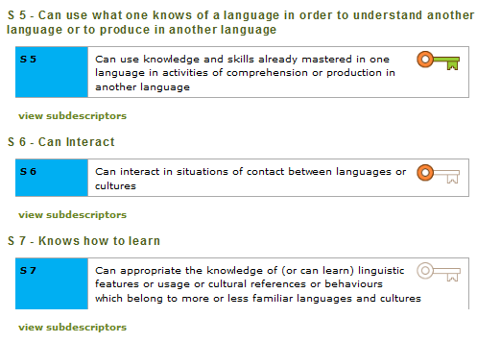


Slide 14
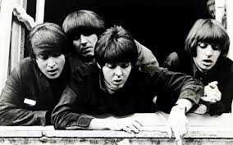
Where do they all come from?

Slide 15
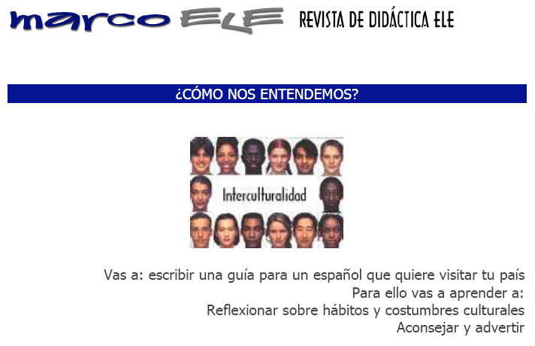
What are pluralistic approaches?
Definition:
The concept of pluralistic approaches refers to didactic approaches which use learning/teaching activities involving several (i.e. more than one) varieties of language or culture.
Intercultural approach(es)
15

Slide 16
“How do we understand each other?”
"You will write a guide for a Spaniard who would like to visit your country.
For this, you will learn how to :
- reflect on cultural habits and customs
- advise and warn."
16
Notes:
16

Slide 17
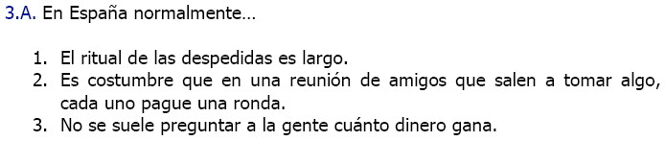
“In Spain, usually the leaving ritual is a long one.”
“When friends meet outside to have a drink together, each of them usually buys a round. ”
“Usually, you don’t ask people how much money they earn.”
17
Notes:
17

Slide 18
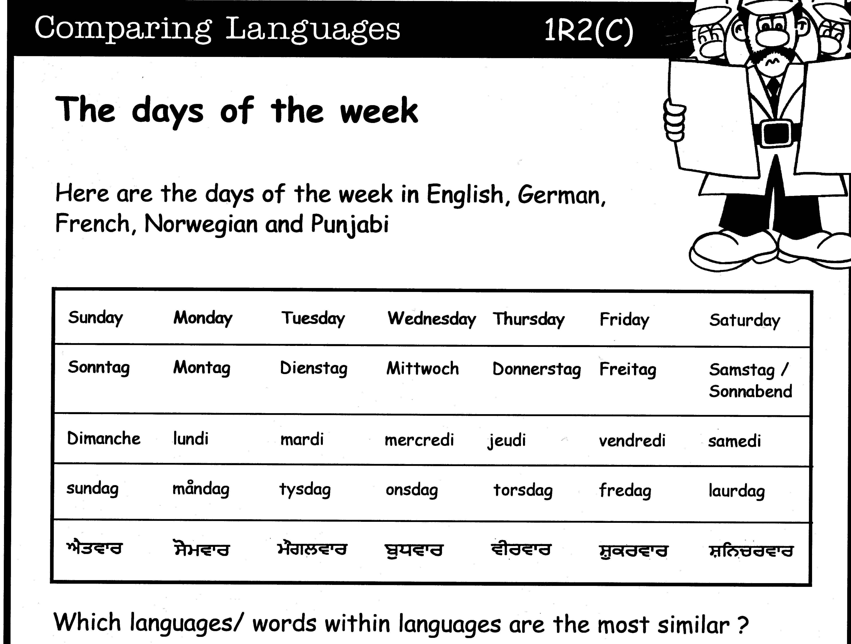
What are pluralistic approaches?
What are pluralistic approaches?
Definition:
The concept of pluralistic approaches refers to didactic approaches which use learning/teaching activities involving several (i.e. more than one) varieties of language or cultures.
Definition:
The concept of pluralistic approaches refers to didactic approaches which use learning/teaching activities involving several (i.e. more than one) varieties of language or cultures.
From: Thinking
through
languages
Coventry
City
Council
Awakening to languages (Language Awareness)
18

Slide 19
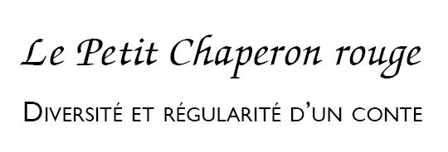
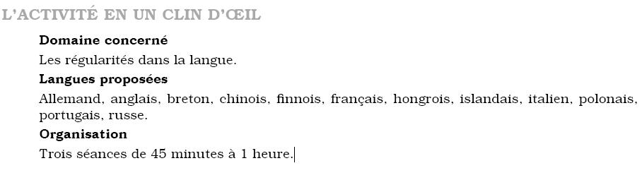
Red Riding Hood
German, English, Breton, Chinese, Finnish, French, Hungarian, Icelandic, Italian, Polish, Portuguese, Russian.
From: Les langues du Monde au Quotidien - Cycle 2, SCEREN (2006, 2012).
Michel Candelier - CEFR Web Conference - 28-29 March 2014
19

Slide 20
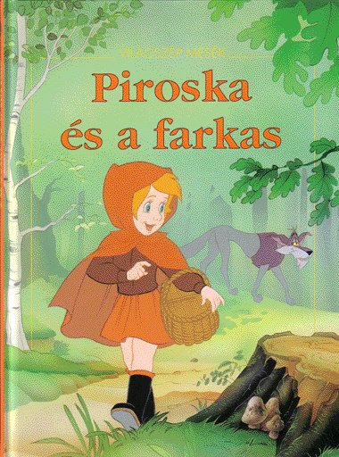
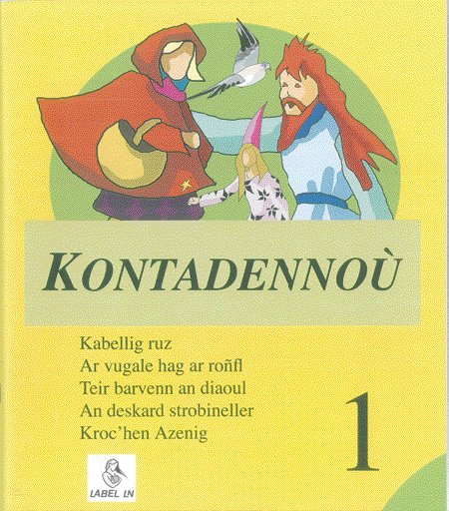
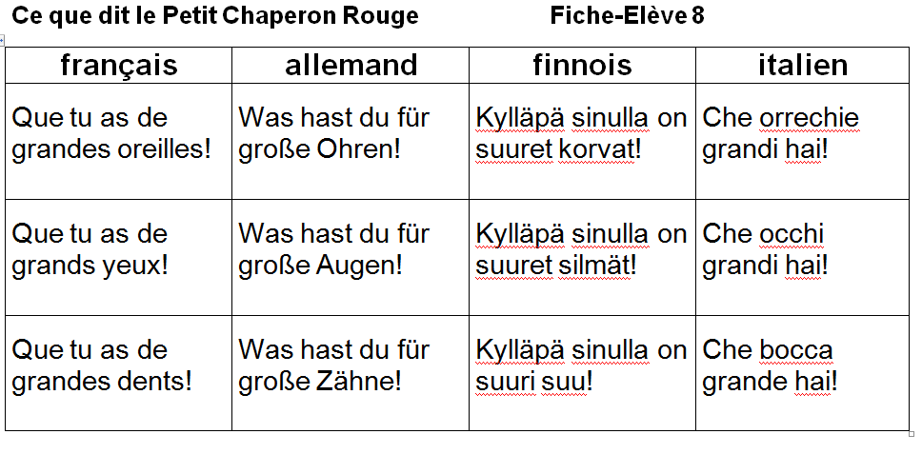
(Hungarian) (Breton)
20

Slide 21
What are pluralistic approaches?
Definition:
The concept of pluralistic approaches refers to didactic approaches which use learning/teaching activities involving several (i.e. more than one) varieties of language or cultures.
English German Your mother tongue
Integrated didactic approach
21

Slide 22
Integrated didactic approach
Example taken from:
Kursiša, A. & Neuner, G. (2006). Deutsch ist easy – Methodische Grundlagen für Deutsch nach Englisch. Ismaning: Hueber.
This material helps students to discover lexical similarities and grammatical differences between both languages, as well as with their own mother tongue (and / or language of education) …
22

Slide 23
23

Slide 24
24

Slide 25
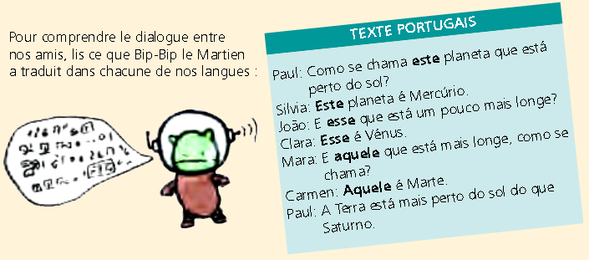
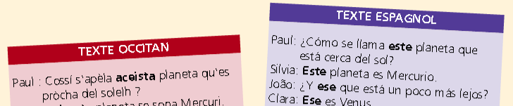
What are pluralistic approaches?
Definition:
The concept of pluralistic approaches refers to didactic approaches which use learning/teaching activities involving several (i.e. more than one) varieties of language or cultures.
Intercomprehension
25

Slide 26
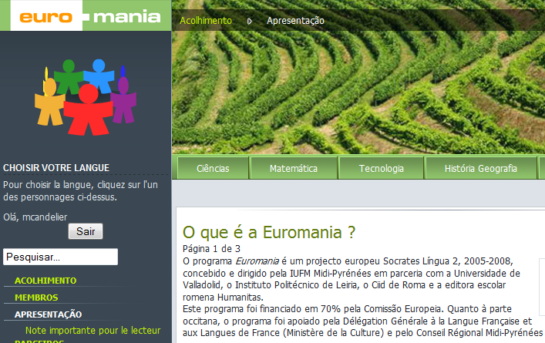
For primary school children speaking one of six romance languages…
… French, Italian, Occitan, Portuguese, Romanian, Spanish.
Something like "CLsIL" - Content and Languages Integrated Learning!
It aims at developping comprehension skills in the other five languages .. while teaching subject matters like physical / life sciences, mathematics, technology, history / geography …
26
26
26
Notes:
26
26

Slide 27
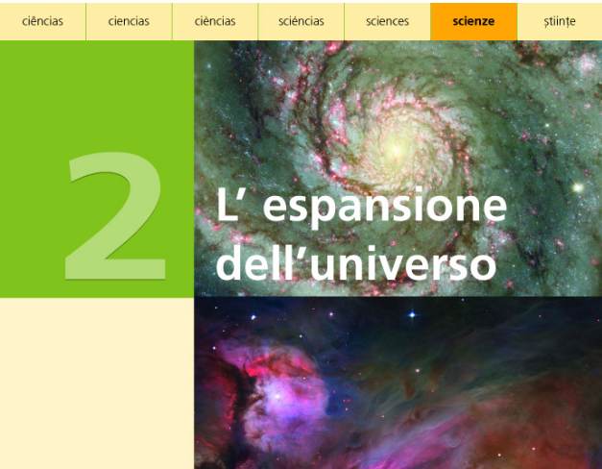
This means, for Italian pupils!
This is why the tasks are given in Italian
This is the Italian version!
"The expansion of the Universe"
27
Notes:
27
27

Slide 28
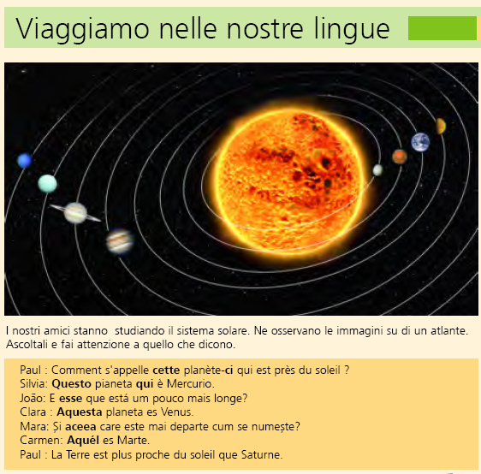
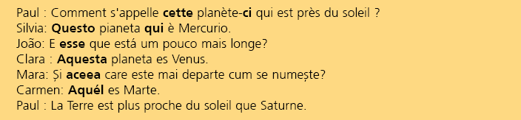
"Let’s have a trip through our languages"
28
Notes:
28
28

Slide 29
"Let’s have a trip through our languages"
"Our friends [speaking different romance languages and understanding each other] are studying the solar system. They are observing the pictures in an atlas. Listen carefully to what they are saying."
29
Notes:
29
29

Slide 30
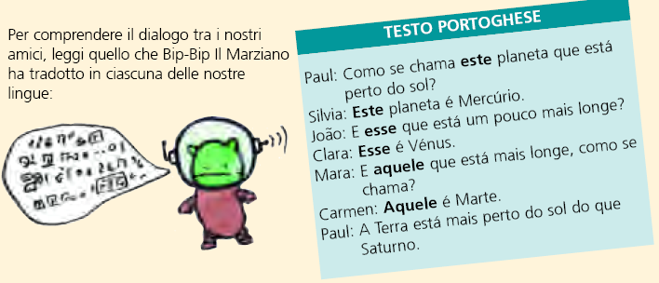
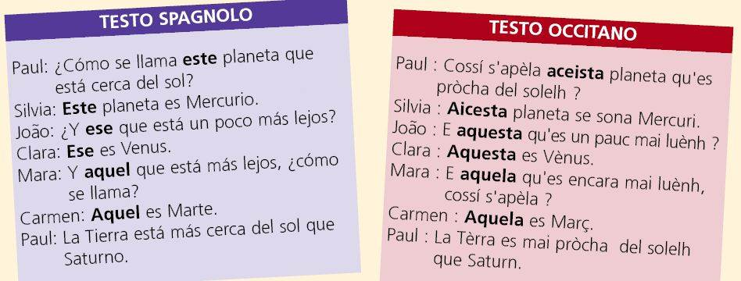
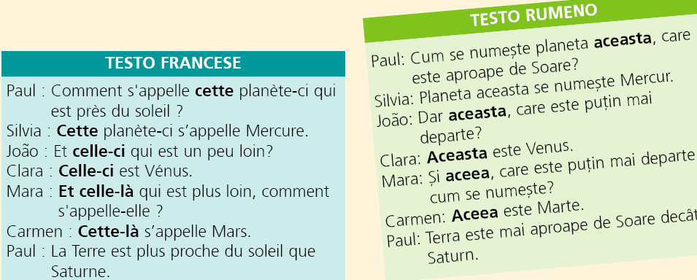
"In order to understand what our friends have said, you should read what Bip-bip the Martian has translated into each of our languages."
30
30
30
Notes:
30
30

Slide 31
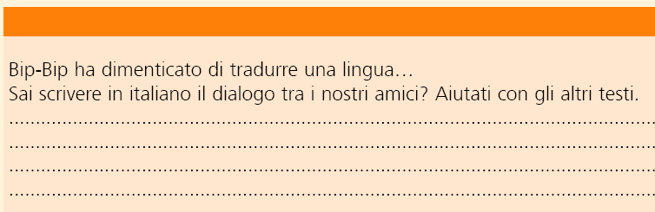
“ Bib-bip has forgotten one language!”
“Can you write in Italian the conversation which took place between our friends? The other texts should help you!”
31
Notes:
31
31

Slide 32
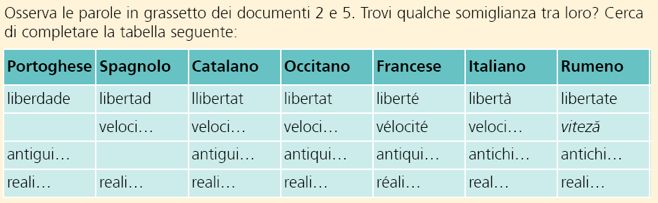
"Observe the words in bold in documents 2 and 5. Find some similarities between them. Try to complete the following table"
The pupils discover the following correspondances:
-ade | -ad | -at | -at | -é | -à | -ate
32
Notes:
32
32

Slide 33
Example of intercomprehension between Slavonic languages: Jeziora Mazurskie
Jeziora Mazurskie i Białowieski Park Narodowy w półfinale konkursu na 7 nowych cudów świata
Wielkie Jeziora Mazurskie i Białowieski Park Narodowy znalazły się w półfinale wyborów 7 nowych cudów świata! Konkurs "7 nowych przyrodniczych cudów świata" realizowany jest od 2008 roku przez szwajcarską fundację "NewOpenWorld Foundation". Głosowanie przebiega w siedmiu kategoriach: "krajobrazy, formy polodowcowe", "wyspy", "góry, wulkany", "jaskinie, formy skalne, doliny", "lasy, rezerwaty i parki narodowe", "jeziora, rzeki, wodospady" oraz "krajobrazy morskie". Wśród półfinalistów znajdziemy między innymi Morze Martwe, włoski wulkan Wezuwiusz i grecką górę bogów - Olimp. Reference:http://www.eurocomslav.de/BIN/inhalt.htm (05.05.13)
1. Somebody will read the Polish text for you. Listen well!
2. Read the text and summarize the content in one sentence.
3. Read the text extensively sentence by sentence.Transfer the text into Croatian (or in other languages you know) and find correspondences (and differences) between these languages.
33

Slide 34
Example of a lesson based on intercomprehension
I‘m discovering the Polish language: You’ve transferred without major problems the Polish text into Croatian. Write down your findings and observations relating to the structure and grammatical forms in the grid below.
 | My findings in the Polish text | Correspondences with ohter languages that I know or that I‘m learning | Remarks
Nouns | Jeziora Park… | jezera
Adjektifs | Mazurskie Białowieski Narodowy półfinale
Verbs
…
34

Slide 35

Where do they all come from?
Integrated didactic approach
Awakening to languages
Intercultural approach(es)
Intercomprehension
35

Slide 36
Competences /vs./ resources?
Competences:
- complexity
- socially relevant tasks
- context
Resources:
- internal
. Knowledge
. Attitudes
. Skills
- external
Ability to select the right resources
36

Slide 37
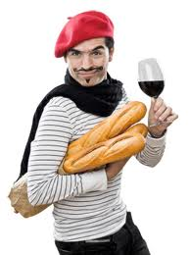
Competences /vs./ resources?
Competences:
- complexity
- socially relevant tasks
- context
Resources:
- internal
. Knowledge
. Attitudes
. Skills
- external
Ability to select the right resources
I will give you a concrete example of this!
37

Slide 38
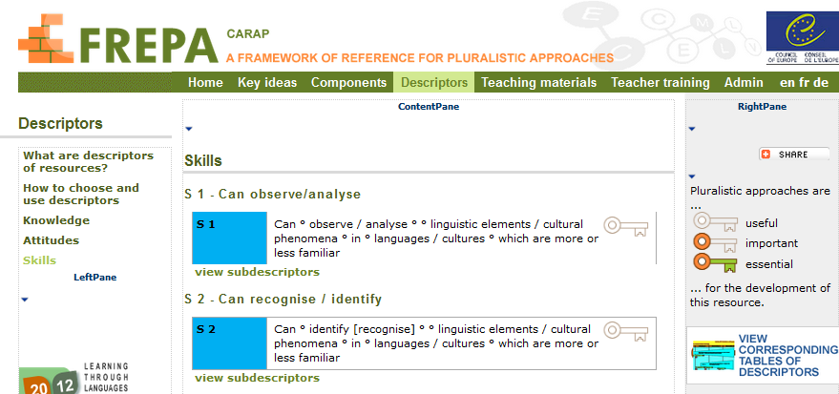
I have acquired some (modest) competence to ask for directions in Japanese.
To make use of this competence, sometimes I do of course use external resources (a dictionary, a grammar) I have in my pocket!
But I also have internal resources:
- Skills: for instance the ability to formulate sentences with the verb in the end…
- Knowledge: for instance the list of the adverbs of place – here, there, over there – and interrogative ones – where, from where…
- Attitudes : I trust in my abilities, I am interested in languages…
And of course, I am able to select the right resources for the task I have to accomplish!!
38

Slide 39
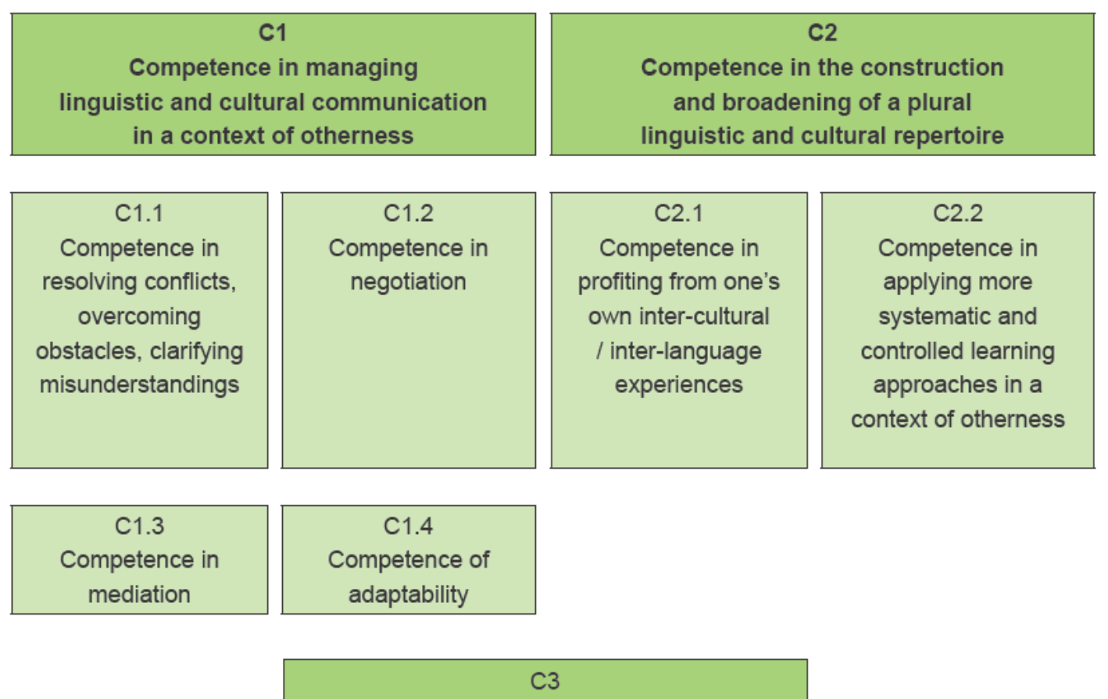


FREPA – Table of competences
Michel Candelier - CEFR Web Conference - 28-29 March 2014
39
39

Slide 40
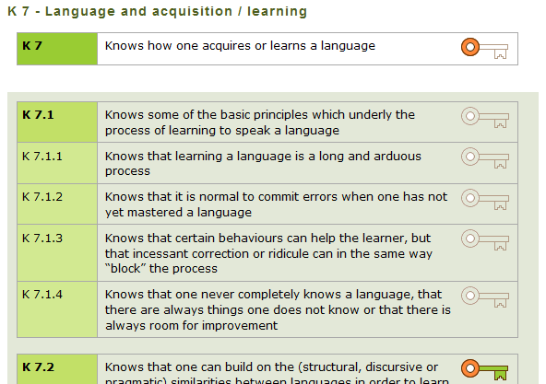
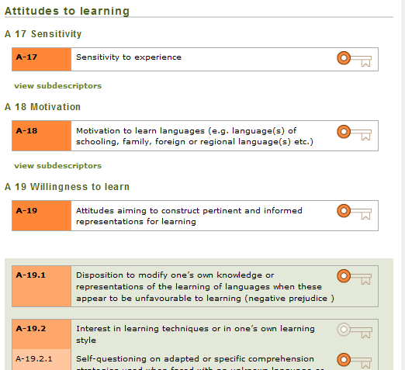
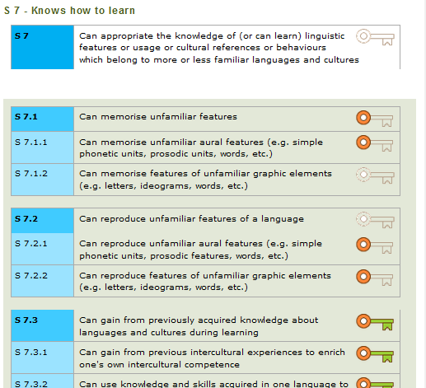
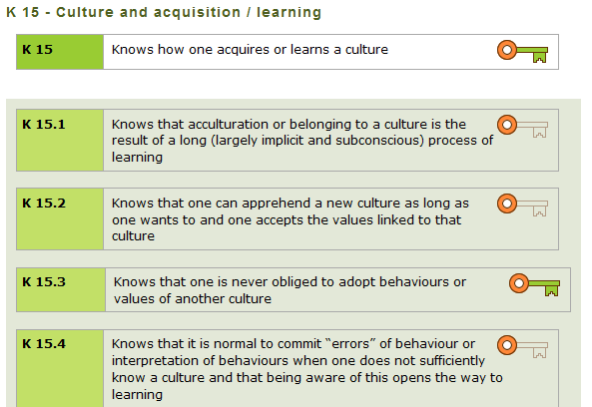

Slide 41
CARAP
FREPA
Welcome to OUR website!
Venez-voir sur notre site!!!
Les listes de savoirs, savoir-être et savoir-faire y sont …
Le CARAP, c’est nous !!!
41

Slide 42
Disseminating pluralistic approaches and FREPA
42

Slide 43
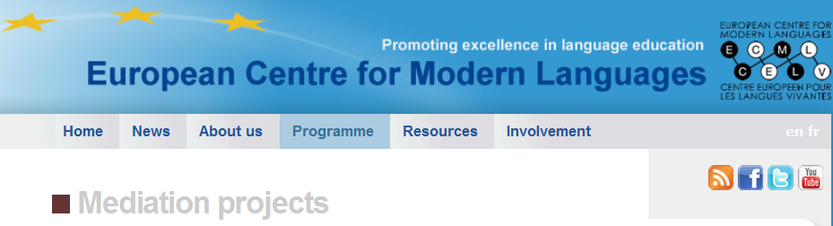
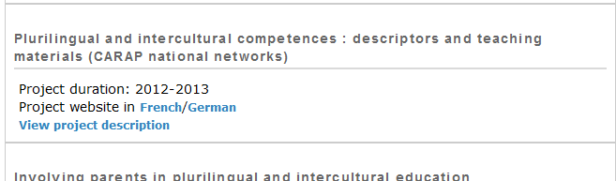
Training events in Armenia, Croatia, Lithuania,
Malta, Poland.
over 20 country pages, in the language(s) of the country.
…
Michel Candelier - CEFR Web Conference - 28-29 March 2014
43

Slide 44
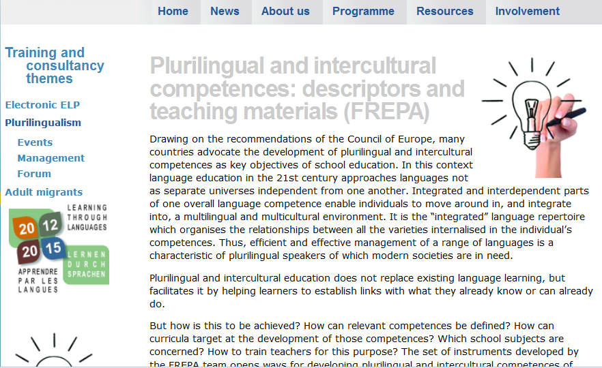
2013: Iceland.
2014, 9 countries : Armenia, Bulgaria, France, Germany(2 events), Malta, Poland, Slovenia, Slovakia, The Netherlands
2015, 7 countries: Croatia, Denmark (2016), Finland, Germany, Romania, Switzerland, The Netherlands
44

Slide 45

European Portfolio for Student Teachers of Languages (EPOSTL)
“Crossing continents: EPOSTL around the world”
Describing language teacher competences with FREPA-descriptors? – Preliminary thoughts
Graz, 18 – 19 February 2014
1- Subdividing the EPOSTL competences wtih reference to FREPA descriptors?
2- Adding competences to some sections?
Anna Schröder-Sura
anna.schroeder-sura@romanistik.uni-giessen.de
Justus-Liebig-Universität Gießen, Germany
FREPA Team member, ECML, Graz
3- Adding a new categorie „Plurilingual and intercultural education“?
Michel Candelier - CEFR Web Conference - 28-29 March 2014
45
45
Notes:
45

Slide 46

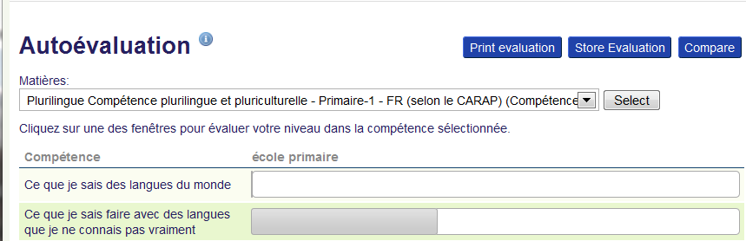
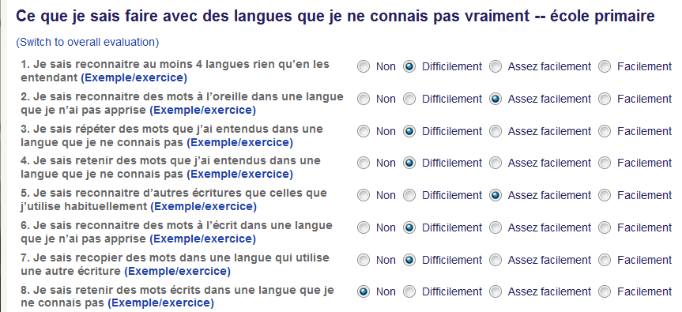
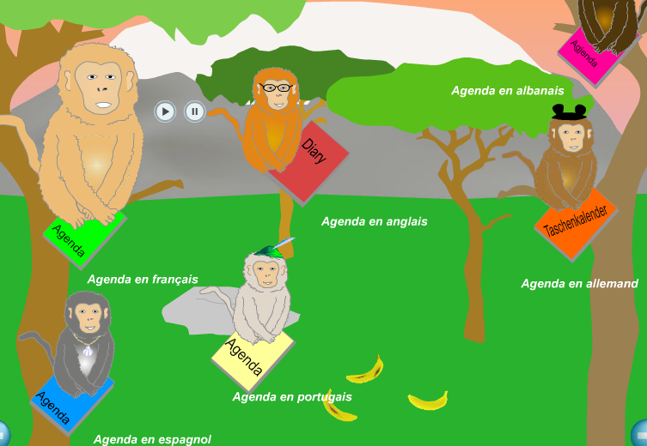
FREPA descriptors | Descriptors for Théo (7-8 year old learner)
S 2.5.1 Can identify languages on the basis of phonological evidence | 1. I can recognise at least four languages while listening
S 2.1.3 Can identify (or recognise) a morpheme or a word while listening | 2. I can recognise words in a language that I havent’t learnt while listening
Michel Candelier - CEFR Web Conference - 28-29 March 2014
46
46
46

Slide 47
FREPA as a complement
to the CEFR
47

Slide 48
Plurilingual and pluricultural competence
and
Pluralistic approaches
CEFR
Chapter 8
… encompassing the full range of languages available to him/her
Guide
2003/7
… not dealt with in isolation … treated as a single competence
48

Slide 49
The contribution of FREPA
to complementing the CEFR
In which domains?
Sets of descriptors for plurilingual and intercultural competences
For a tool helping to develop language learning competences
Basis for a reference tool for teachers’ competences
49

Slide 50

dank u wel
gmadlobth
obrigado
спасибо
tanemirt
Ευχαριστώ
enkosi
kiitos
misaotra
50
Notes:
50

