Slide 1

Intercomprehension between related languages

Slide 2
If I had to reduce all of educational psychology to just one principle, I would say this: The most important single factor in influencing learning is what the learner already knows. (Ausubel 1968: vi)

Slide 3
Pluralistic approaches to languages and cultures
Four pluralistic approaches
It entails the comparative study and learning of two or more languages from one and the same family (Romance, Germanic, Slavonic languages, etc)
Awakening to languages
Integrated didactic approach
Intercomprehension between related languages
The aim is first and foremost to develop written or oral comprehension skills.
3
Notes:
3

Slide 4
An activity based on intercomprehension:
Die Rübe
Which knowledge, attitudes, skills
can be developed by this activity?

Slide 5
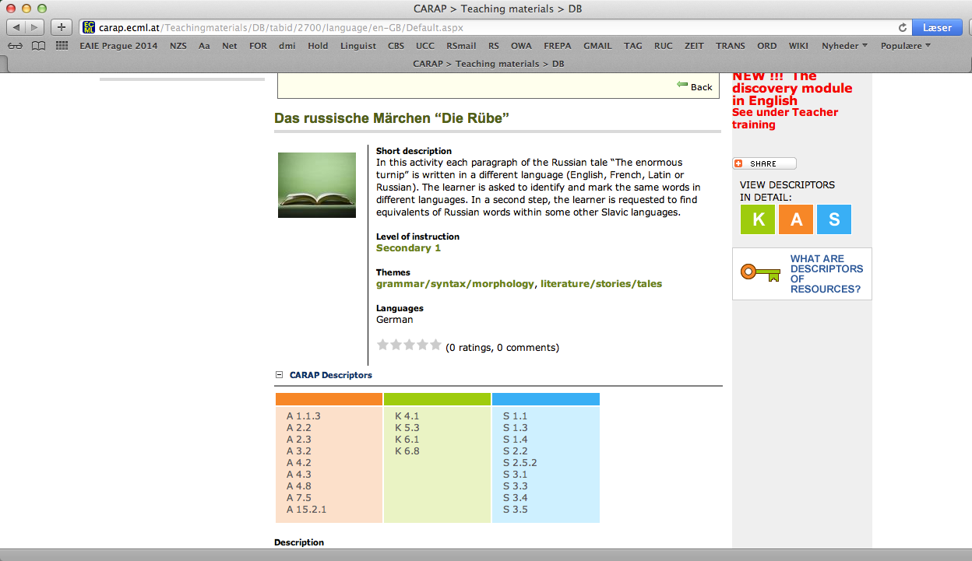

Slide 6
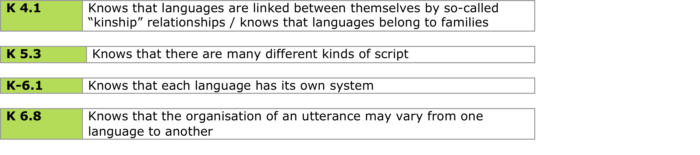
Knowledge

Slide 7
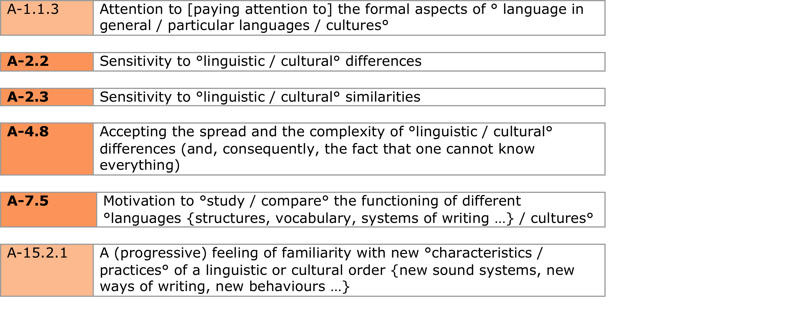
Attitudes, some examples

Slide 8
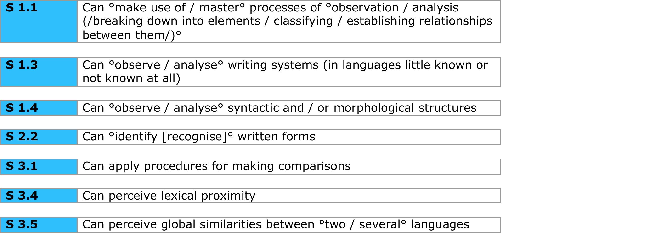
Skills, some examples

Slide 9
The Seven sieves – a way of classifying transferable elements which contribute to intercomprehension

Slide 10
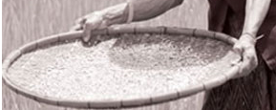
Galińska-Inácio, I., Randak, A., C., Klein, H. G. et Stegmann, T. D., (2004). EuroComRom – Siedem sit: Jak od razu czytać teksty w językach romańskich.
linguistic phenomena in the text
linguistic
phenomena
that
the learner
is able
to recognize
Sieve 1
remaining phenomena
Sieve 2
remaining phenomena
Sieve 3

Slide 11
Sieve 1
International vocabulary
Sieve 2
Pan-Slavic vocabulary
Sieve 3
Sound correspondence
Sieve 4
Spelling and Pronunciation
Sieve 5
Pan-Slavic syntactic structure
Sieve 6
Morphosyntax
Sieve 7
Prefixes and suffixes

Slide 12
Intercomprehension and the Lithuanian Curriculum – Discussion :
For whom?
When?
How?
…
…
…

