Slide 1
CARAP
FREPA
F R E P A
A Framework of Reference for Pluralistic Approaches to Languages and Cultures
DISCOVERY MODULE
1

Slide 2


Hello everybody! Nice to meet you! My name is Carapito. I will be guiding you through this module!
I hope you have been able to find partners to work with… It is more fun that way!
But it is not necessary. You can also work alone…
As you will see, many people will accompany you!
2

Slide 3
May I introduce…
First of all, Professor Uhu. He believes he is a great scientist. Never contradict him! He could get very angry!
Professor PhD Uhu
And then, our merry band
“the happy Frepies”.
They know the FREPA very well and are keen to help you. They are just a little provocative …
Everybody there?
Let’s go!
The happy Frepies
3

Slide 4
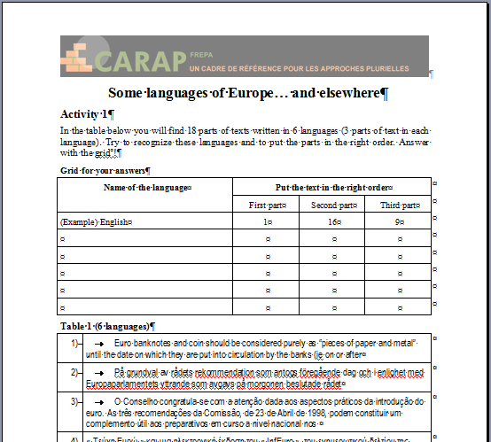
First step
… and don’t click before you have finished!
An example of a teaching material
(YOU are the learners!)
… we are watching you!
* Download the document Some languages of Europe… and elsewhere
4

Slide 5
First step
An example of a teaching material
(YOU are the learners!)
Are you sure you have finished?
….
OK, click again!
5

Slide 6
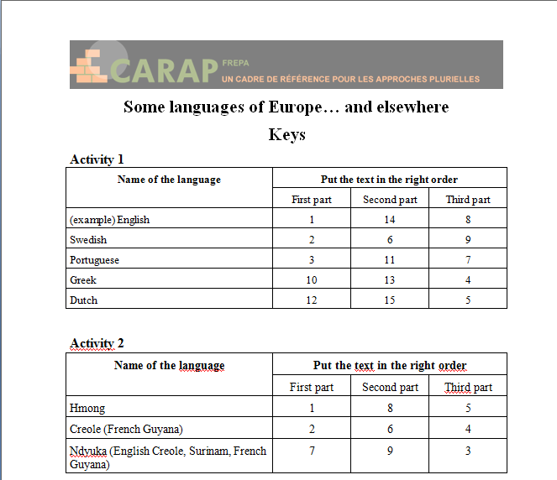
First step
An example of a teaching material
(YOU are the learners!)
Now, you may have a look at the keys !!!
Check whether everything is OK
(Pair work if possible…)
* Download the document Some languages of Europe… and elsewhere – Keys
6

Slide 7
An example of teaching material – YOU are the learners!
An example of a teaching material
(YOU are the learners!)
What kind of knowledge / attitudes / skills can be developed through this activity?
Let’s go on to the next step!
I think, with these kind of activities, my students would become aware that…
Write down your ideas carefully (on a sheet of paper)! If possible, do this in pairs
Yes, and they would be able to … …
We shouldn’t forget the attitudes!
7

Slide 8
An example of teaching material – YOU are the learners!
An example of a teaching material
(YOU are the learners!)
What kind of knowledge / attitudes / skills can be developed through this activity?
OK ! We will use your notes later…
Finished!
8

Slide 9
Let’s come back to what you have done during the activity… We have stated that you have established links between languages …
And when you learn a language, do you do so as well?
Please reflect on this before you go to the next slide…
9

Slide 10
Let’s come back to what you have done during the activity… We have stated that you have established links between languages …
And when you teach a language?
Again, think about it before you go to the next slide…
10

Slide 11
Let’s come back to what you have done during the activity… We have stated that you have established links between languages …
And when you learn a language, do you do so as well?
And when you teach a language?
…
…
If you are working with others, share your answers to both questions!
11

Slide 12
Professor Uhu’s comment…
It is well known that many language teachers are lost in a contradiction: Their own experience teaches them that learning implies referring to what one already knows, that this helps learning in many cases (in case of similarities between languages…
Professor! May I give an example… my example…
12

Slide 13
Professor Uhu’s comment…
Well… If you cannot refrain
from it …
I have learnt German before learning Japanese… And this helps me a lot !
I have no problem with putting the verb in Japanese at the end of the sentence… It is like in German dependent clauses…!
13

Slide 14
Professor Uhu’s comment…
Quickly, please…!
And when I tried to learn some Modern Greek, I had no problem with the sounds [θ] and [ð] because I know them from English, or with [x] and [ç] because I know them from German…!
14

Slide 15
Professor Uhu’s comment…
Let me go on! … Teachers have also often experienced in their own learning that being aware of differences helps to avoid so called “interferences”…
Still, many teachers remain under the influence of teaching principles established in the course of the second half of the previous century, according to which each language should be taught in isolation. They even feel guilty when they refer to other languages when teaching “their” language…
15

Slide 16
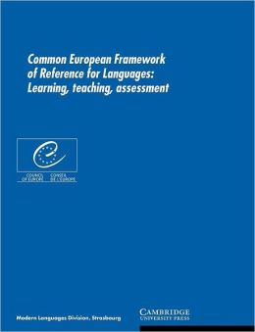
Can you find any link between the issues we just discussed and this extract from the Common European Framework of Reference?
First think, then click!
Referring to the plurilingual and pluricultural Competence:
“a given individual does not have a collection of distinct and separate competences to communicate depending on the languages he/she knows, but rather a plurilingual and pluricultural competence encompassing the full range of the languages available to him/her”. (p. 168)
16

Slide 17
Of course, there is a link !
If we refer to other languages when confronted with a new language, it is because languages are not separate in our mind… Our plurilingual competence is covering all languages we have!
Referring to the plurilingual and pluricultural Competence:
“a given individual does not have a collection of distinct and separate competences to communicate depending on the languages he/she knows, but rather a plurilingual and pluricultural competence encompassing the full range of the languages available to him/her”. (p. 168)
17

Slide 18
Yes, Professor! We know!
Psycholinguists agree about the existence of ONE system (it is the so called “wholist” conception of a plurilingual competence) …
This conception of plurilingual competence relies on psycholinguistic research work carried out on language acquisition in the last decades (see for instance the model developed by Herdina & Jessner, 2002)
Although the views of Psycholinguists may differ concerning the existence of “separate systems” within this global plurilingual competence.
Professor PhD Uhu
18

Slide 19
The consequences are clearly outlined in the in the Guide for the development and implementation of curricula for plurilingual and intercultural education , 2010, 21.
Professor PhD Uhu
Every opportunity to encourage pupils to use knowledge and competences acquired in languages they are taught or know must
be taken, in order to highlight points of convergence, and to help them to understand how languages work, and to develop their plurilingual repertoires in an optimal way.
19

Slide 20
This was already stated in the Guide for the Development of Language Education Policies in Europe, 2007, 37-38 :
Professor PhD Uhu
The “pedagogical nature” of the definition of this plurilingual and pluricultural competence “calls for the teaching of different languages to be linked to one another […] because they are likely to bring into play the same skills”.
20

Slide 21
But how can we link different languages to one another in teaching?
Are there any approaches which try to put this into practice?
The “pedagogical nature” of the definition of this plurilingual and pluricultural competence “calls for the teaching of different languages to be linked to one another […] because they are likely to bring into play the same skills”.
21

Slide 22
Well…
???
Which ones link different languages to one another?
There are two kinds of teaching approaches :
Pluralistic approaches to languages and cultures, referring to didactic approaches which use teaching / learning activities involving several (i.e. more than one) varieties of languages or cultures;
Approaches which might be called “singular” in which the didactic approach takes account of only one language or a particular culture, and deals with it in isolation.
22

Slide 23
I would say Pluralistic approaches!
Which ones link different languages to one another?
There are two kinds of teaching approaches :
Pluralistic approaches to languages and cultures, referring to didactic approaches which use teaching / learning activities involving several (i.e. more than one) varieties of languages or cultures;
Approaches which might be called “singular” in which the didactic approach takes account of only one language or a particular culture, and deals with it in isolation.
23

Slide 24
I would say Pluralistic approaches!
Yes, pluralistic approaches!
How can you help students to link languages to one another if you don’t deal with more than one language in your classroom activities!
Really too easy!!!
There are two kinds of teaching approaches :
Pluralistic approaches to languages and cultures, referring to didactic approaches which use teaching / learning activities involving several (i.e. more than one) varieties of languages or cultures;
Approaches which might be called “singular” in which the didactic approach takes account of only one language or a particular culture, and deals with it in isolation.
24

Slide 25
And besides, this is exactly what we have experienced with the activity Languages of Europe … and elsewhere!
Yes, pluralistic approaches !
How can you help students to link languages to one another if you don’t deal with more than one language in your classroom activities?
There are two kinds of teaching approaches :
Pluralistic approaches to languages and cultures, referring to didactic approaches which use teaching / learning activities involving several (i.e. more than one) varieties of languages or cultures;
Approaches which might be called “singular” in which the didactic approach takes account of only one language or a particular culture, and deals with it in isolation.
25

Slide 26
There are two kinds of teaching approaches:
Pluralistic approaches to languages and cultures, referring to didactic approaches which use teaching / learning activities involving several (i.e. more than one) varieties of languages or cultures;
Approaches which might be called “singular” in which the didactic approach takes account of only one language or a particular culture, and deals with it in isolation.
26

Slide 27
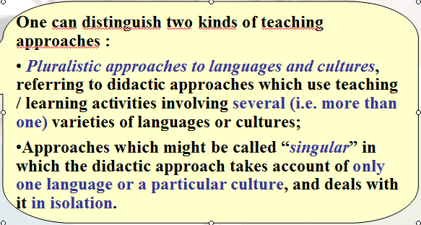

It would be great to know more about Pluralistic approaches…
Are there many of them ?
OK, but first, I am asking myself… Although I am convinced that we should use pluralistic approaches, teaching a specific language surely means focusing on this language. Do people promoting pluralistic approaches propose to abandon teaching languages as such??
I would be happy to see other concrete examples like the Languages of Europe… activity.
Maybe, we already know some of them?
27

Slide 28
Not at all!
But it is still too early to give you a more detailed answer.
You should ask Professor Uhu a bit later, once he has told you more about Pluralistic approaches.
OK, but first, I am asking myself… Although I am convinced that we should use pluralistic approaches, teaching a specific language surely means focusing on this language. Do people promoting pluralistic approaches propose to abandon teaching languages as such??
28

Slide 29
FOUR PLURALISTIC APPROACHES
Four pluralistic approaches have emerged in Language teaching methodology over the past thirty years:
• awakening to languages;
• intercomprehension between related languages;
• intercultural approach;
• integrated didactic approach to different languages
studied.
Professor PhD Uhu
… which all correspond to the definition we have given and which the authors of the FREPA decided to subsume under the term “Pluralistic approaches”.
29

Slide 30
FOUR PLURALISTIC APPROACHES
Professor PhD Uhu
Most certainly!!!
I am Professor
PhD Uhu!
Excuse me Professor, if I may…don’t be too long. Give just one example for each approach!
Please Professor, can you explain to us what these four approaches are and give us some examples?
30

Slide 31
Awakening to languages
(also known as Language awareness)
Professor PhD Uhu
Defined as an approach in which some of the learning activities are concerned with languages which the school does not intend to teach.
Yes, we did!!!
Didn’t we do that at the beginning… with the Languages of Europe and elsewhere… activity?
31

Slide 32
Awakening to languages
(also known as Language awareness)
Professor PhD Uhu
Defined as an approach in which some of the learning activities are concerned with languages which the school does not intend to teach.
Of course the approach is not concerned exclusively with such languages, it deals also with the language(s) of education and any other language learnt.
It integrates all sorts of linguistic varieties – from the environment, home languages of pupils, … from all over the world …
32

Slide 33
Awakening to languages
(also known as Language awareness)
Professor PhD Uhu
It has been designed principally as a way of welcoming schoolchildren into the world of linguistic diversity and the diversity of their own languages at the beginning of school education …
… and also as a vector of fuller recognition of the languages “brought” into the school by children with other home languages, as a kind of preparatory course developed at primary schools, but it can also be promoted as a support to language learning throughout the learners’ school career.
And now an example (for primary school):
33

Slide 34

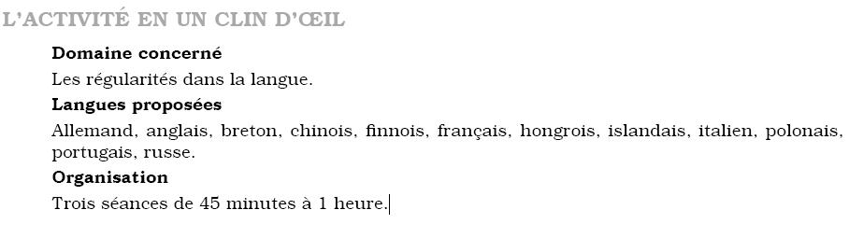
Red Riding Hood
German, English, Breton, Chinese, Finnish, French, Hungarian, Icelandic, Italian, Polish, Portuguese, Russian.
From: Les langues du Monde au Quotidien - Cycle 2, SCEREN (2006, 2012).
34

Slide 35
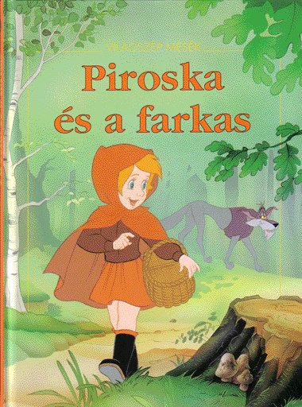
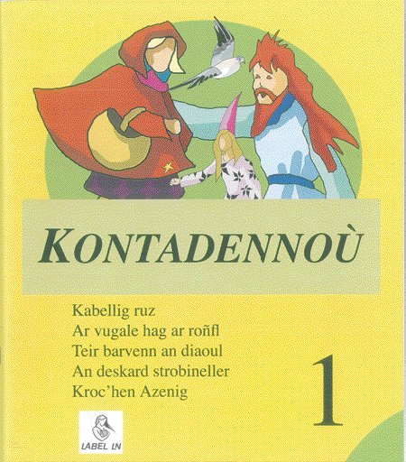
Aims:
Discovering that there is nothing like term to term translation between languages, that all languages present identifiable ways of linking form and meaning.
Discovering the embedding of the same recognised fairy tale in different cultural contexts.
(Hungarian) (Breton)
35

Slide 36
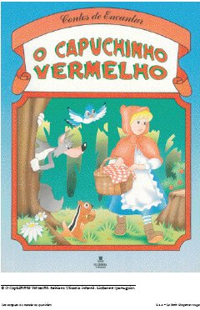
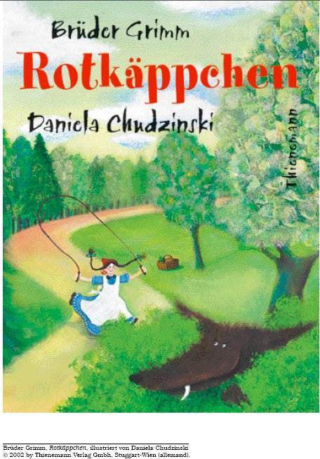
Listen to the titles of the tale Red Riding Hood in four languages:
Listen to it !
(Portuguese) (German)
36

Slide 37
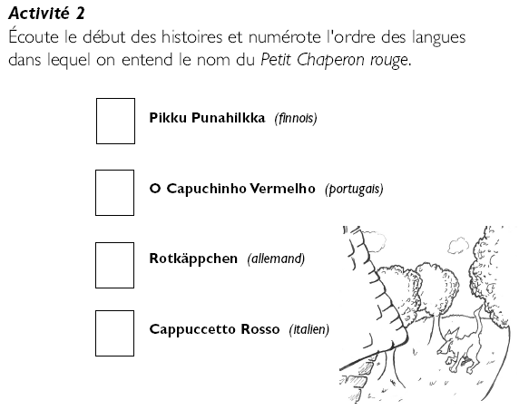
Listen to the beginning of the tales and indicate in which order the four languages appear.
Listen to it!
(Portuguese) (German)
37

Slide 38
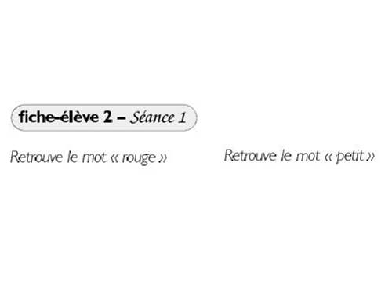
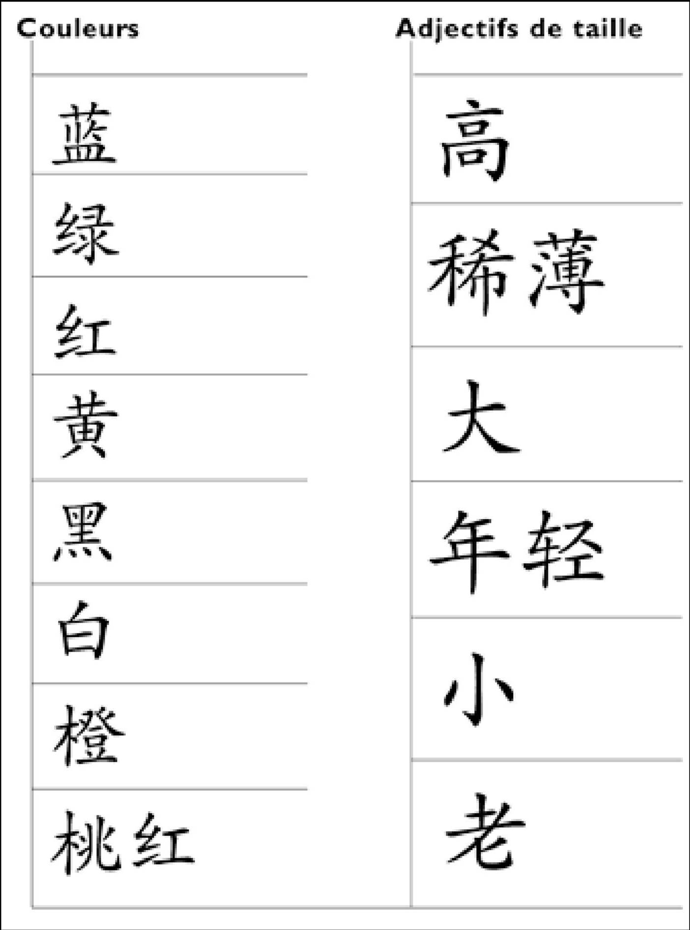
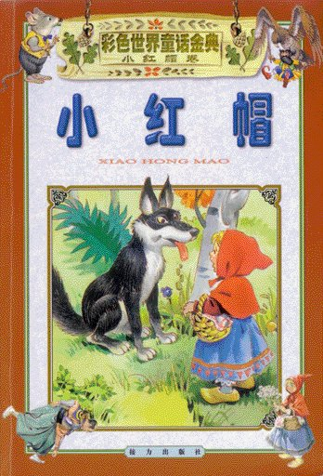
Research task : Title in Chinese
Identifying,,locating, selecting
Find the word “red”
Find the word “little”
Little
red
Ridinghood
38

Slide 39
Intercomprehension between related languages
In the approach termed Intercomprehension between related languages the learner works on two or more languages from the same linguistic family (Romance, Germanic, Slavic languages, etc.) in parallel. One of these languages is already known, being either the learner’s mother tongue, or the language of education, or even another previously learnt language.
Professor PhD Uhu
In this approach there is a systematic focus on receptive skills, as the development of comprehension is the most tangible way of using the knowledge of a related language to learn a new one. Of course, this does not exclude some added benefits for productive skills.
I have chosen the following example for you.
39

Slide 40
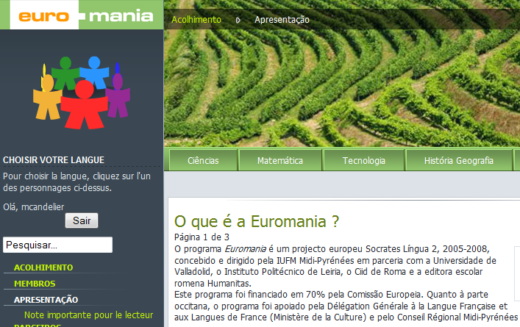
Euromania! Not a bad example!
Yes! A very attractive material. For primary school children speaking one of six romance languages…
… French, Italian, Occitan, Portuguese, Romanian, Spanish.
Something like "CLsIL" - Content and Languages Integrated Learning!
Of course, there also exist intercompre-hension materials aiming at the understanding of only one language!
It aims at developping comprehension skills in the other five languages .. while teaching subject matters like physical / life sciences, mathematics, technology, history / geography …
40

Slide 41
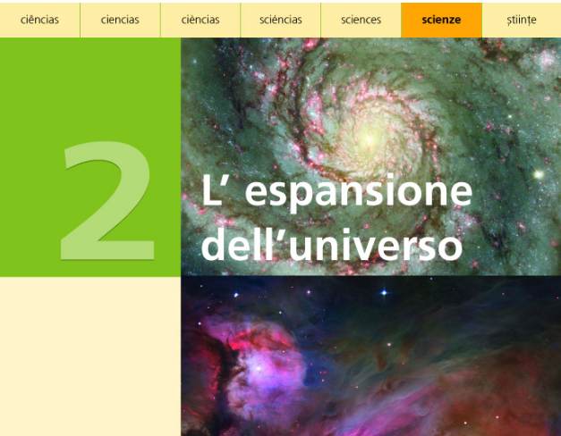
This means, for Italian pupils!
This is why the tasks are given in Italian
Our dear Professor has chosen the Italian version!
"The expansion of the Universe"
41

Slide 42
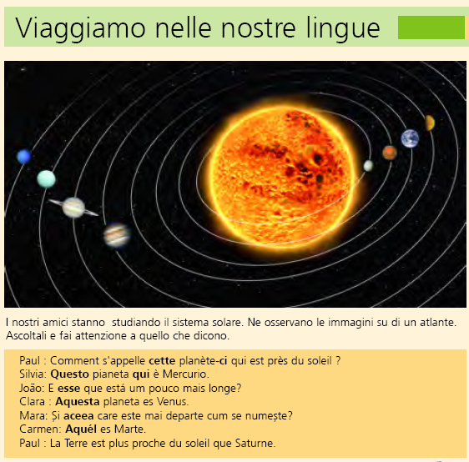
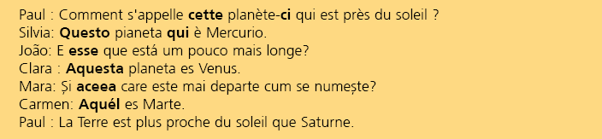
"Let’s have a trip through our languages"
They are marvellous these "Happy Frepies"! They understand so many languages!
42

Slide 43
"Let’s have a trip through our languages"
"Our friends [speaking different romance languages and understanding each other] are studying the solar system. They are observing the pictures in an atlas. Listen carefully to what they are saying."
43

Slide 44
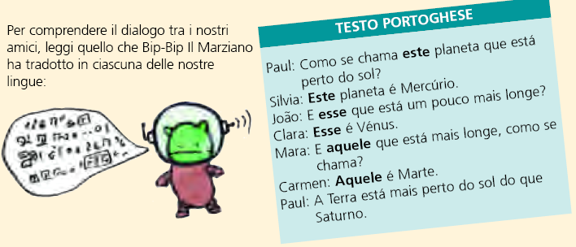
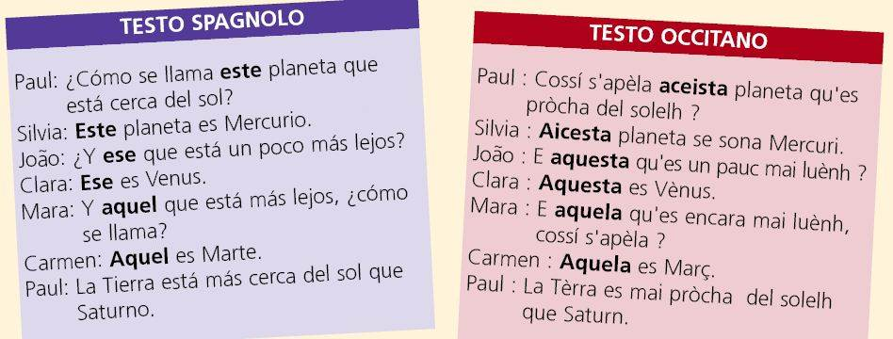
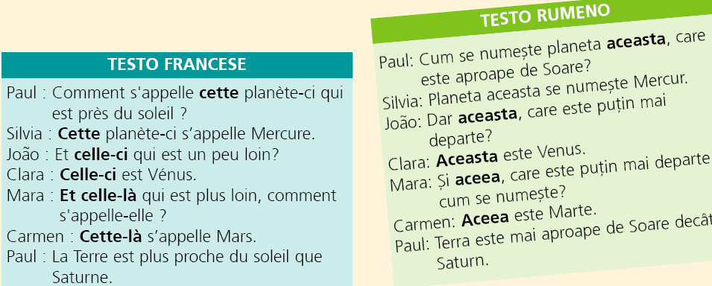
"In order to understand what our friends have said, you should read what Bip-bip the Martian has translated into each of our languages."
44

Slide 45
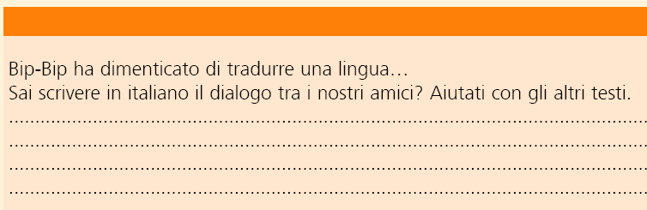
“ Bib-bip has forgotten one language!”
“Can you write in Italian the conversation which took place between our friends? The other texts should help you!”
45

Slide 46
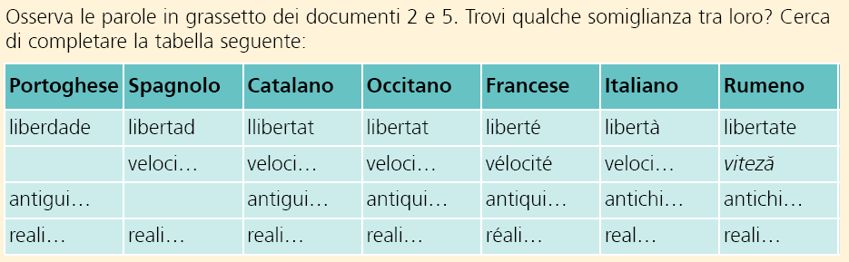

Comprehension activities are followed by tasks involving a comparative reflection on language…
"Observe the words in bold in documents 2 and 5. Find some similarities between them. Try to complete the following table"
The pupils discover the following correspondances:
-ade | -ad | -at | -at | -é | -à | -ate
46

Slide 47

Intercultural approach
The Intercultural approach has already had a clear influence on the methodology of language teaching and is therefore relatively well-known.
Its many variants are all based on didactic principles which recommend relying on phenomena pertaining to one cultural area to approach phenomena pertaining to another one. They also advocate developing strategies to promote reflection about contact situations involving persons with different cultural background.
Professor PhD Uhu
We of course conceive of these cultural areas as hybrid, open and dynamic.
And now, we need
an example!
Shh! If you don’t need it go directly to the presentation of the next Approach!
47

Slide 48
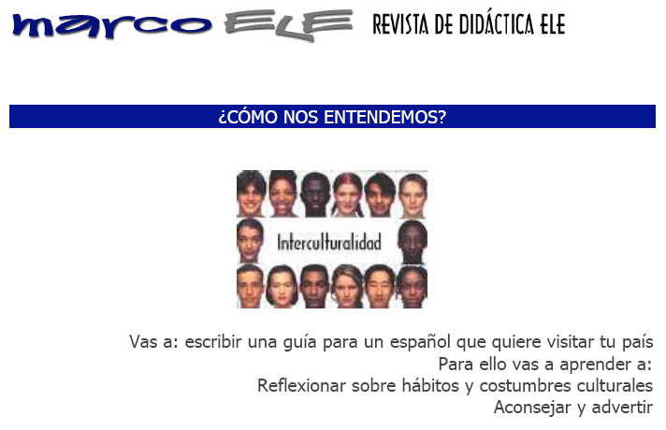
This is from a Journal for Spanish Teaching. The tasks are given in Spanish, for advanced students
“How do we understand each other?”
Note that in order to do this, they have to think about what may happen in their country and compare it with what they are said about Spain.
"You will write a guide for a Spaniard who would like to visit your country.
For this, you will learn how to :
- reflect on cultural habits and customs
- advise and warn."
48

Slide 49
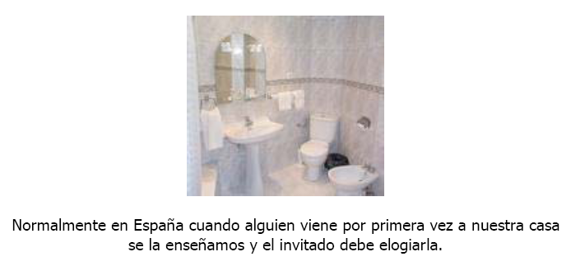
“In Spain, usually when people come to us for the first time, we show them our place and the guests are supposed to say how nice it is.”
49

Slide 50
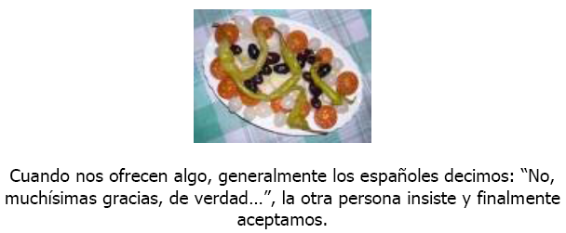
“When they are offered something, it is usual for Spaniards to say “No, thank you very much, really… ”, the other person insists and finally we do accept.”
50

Slide 51
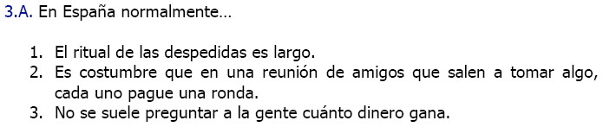
More about this activity?
“In Spain, normally the leaving ritual is a long one.”
“When friends meet outside to have a drink together, each of them usually buys a round. ”
“Usually, you don’t ask people how much money they earn.”
51

Slide 52
Integrated didactic approach
Integrated didactic approaches are directed towards helping learners establish links between a limited number of languages, which are taught within the school curriculum. Integrated didactics work on the central principle advocated by pluralistic approaches of capitalising on what is already known in order to access what is less known : the language of schooling for accessing the first foreign language, which can then be used as a springboard to facilitate the acquisition of a second foreign language etc., keeping in mind that mutual support between languages goes in both directions.
Professor PhD Uhu
This approach does not neglect, either, the home languages of the learners, especially when they are explicitly taught. One can therefore have two (or even three or four) languages which are being “tackled” simultaneously.
52

Slide 53
Integrated didactic approach
This was an approach advocated as early as the beginning of the 1980s in the work of E. Roulet. It is also the direction taken by numerous projects exploring the idea of German after English when they are learnt as foreign languages (cf. the studies relating to Tertiary language learning).
Professor PhD Uhu
Other studies investigate ways of linking the language of schooling and other languages taught in an integrated manner.
It is also present in certain approaches to bilingual education, which seek to make learners identify similarities and differences between the languages used in teaching, irrespective of the subject being taught.
53

Slide 54
This is the first example Professor Uhu would like to show you. It is from:
Kursiša, A. & Neuner, G. (2006). Deutsch ist easy – Methodische Grundlagen für Deutsch nach Englisch. Ismaning: Hueber.
This material helps students to discover lexical similarities and grammatical differences between both languages, as well as with their own mother tongue (and / or language of education) …
It is intended for students who have already learnt some English and are starting to learn German.
54

Slide 55
55

Slide 56
56

Slide 57
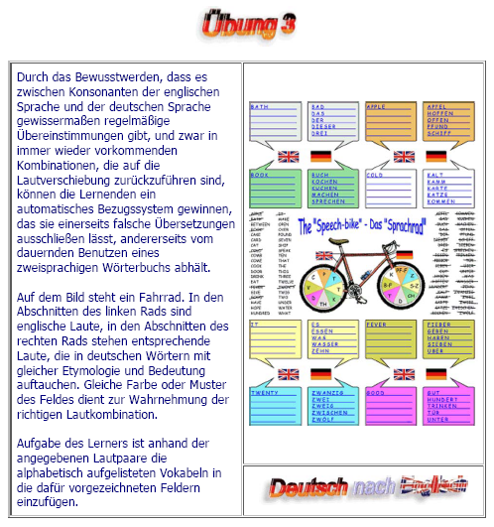
Another example: From Übungsvorschläge für „Deutsch nach Englisch“ – M. C. Berger & A. Colucci.
http://ospitiweb.indire.it/ictavagnacco/deutsch/deutsch_nach_englisch/Ex_3.htm
Making students aware of the existing regular correspon-dence between consonants in German and in English.
The consonants in English are represented in the left wheel, those in German in the right one.
The task for the student is to find among a list of English words the word corresponding to each German item…. Like this…
57

Slide 58
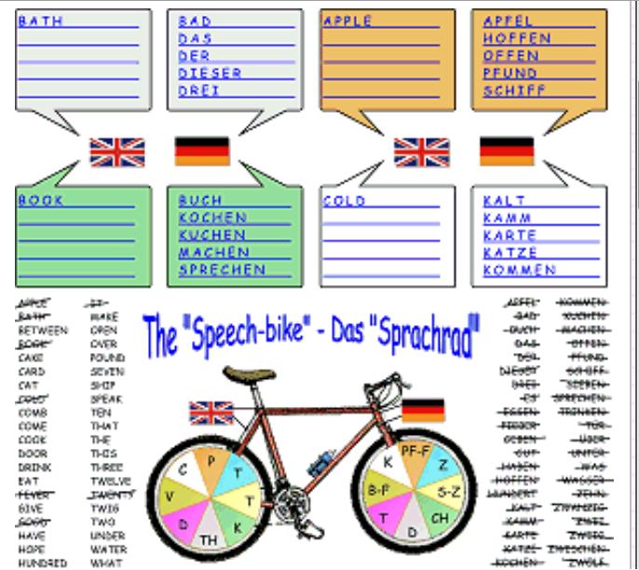
CAKE
CAKE
HAVE
?
CARD
HOPE
(German after English)
CAT
HUNDRED
COMB
MAKE
COME
OPEN
COOK
OVER
DOOR
POUND
DRINK
SEVEN
EAT
SHIP
GIVE
SPEAK
…
58

Slide 59
CAKE
HOPE
CAKE
HAVE
OPEN
POUND
CARD
HOPE
SHIP
(German after English)
CAT
HUNDRED
COMB
MAKE
COME
OPEN
COOK
OVER
DOOR
POUND
DRINK
SEVEN
EAT
SHIP
GIVE
SPEAK
…
59

Slide 60
CAKE
HOPE
CAKE
HAVE
OPEN
POUND
CARD
HOPE
SHIP
(German after English)
CAT
HUNDRED
COMB
MAKE
COME
OPEN
?
COOK
OVER
DOOR
POUND
DRINK
SEVEN
EAT
SHIP
GIVE
SPEAK
…
60

Slide 61
CAKE
HOPE
CAKE
HAVE
OPEN
POUND
CARD
HOPE
SHIP
(German after English)
CAT
HUNDRED
COMB
MAKE
COOK
COME
OPEN
CAKE
MAKE
SPEAK
COOK
OVER
DOOR
POUND
DRINK
SEVEN
EAT
SHIP
And so on……
GIVE
SPEAK
…
61

Slide 62

I think it is time now to repeat the question you had earlier for Professor Uhu.
CAKE
HOPE
CAKE
HAVE
OPEN
POUND
CARD
HOPE
SHIP
Professor PhD Uhu
(German after English)
CAT
HUNDRED
What?!?!
COMB
MAKE
OK, thank you Mr Carapito.
… Dear Professor, do you think pluralistic approaches should replace existing language learning?
Don’t you remember what I said about this Integrated didactic approach? Well, I repeat:
“Integrated didactic approaches are directed towards helping learners to establish links between a limited number of languages, which are taught within the school curriculum.”
This should already be an answer to your question!
Well, I think you need further explanations…
COOK
COME
OPEN
CAKE
MAKE
SPEAK
COOK
OVER
DOOR
POUND
DRINK
SEVEN
EAT
SHIP
GIVE
SPEAK
…
62

Slide 63
CAKE
HOPE
CAKE
HAVE
OPEN
POUND
CARD
HOPE
SHIP
Professor PhD Uhu
(German after English)
CAT
HUNDRED
… Pluralistic approaches help learners to establish links with what they already know and can already do. This can be seen as a basic principle of any learning, so why not applying it for the purpose of language learning? Taken as an overall framework for language education, pluralistic approaches contribute to the teaching of specific languages – by no means do they replace classes for French, Italian, Swedish, English, etc.
Using pluralistic approaches doesn’t mean that you will be always prompting students to compare between languages or cultures – but, at appropriate phases, links and relationships are being highlighted and investigated rather than ignored.
COMB
MAKE
OK, thank you Mr Carapito.
… Dear Professor, do you think pluralistic approaches should replace existing language learning?
COOK
COME
OPEN
CAKE
MAKE
SPEAK
COOK
OVER
DOOR
POUND
DRINK
SEVEN
EAT
SHIP
GIVE
SPEAK
…
63

Slide 64
Very interesting. I have to read more about this later …
…But back to this activity…
It’s strange…
I would say, it could also be a good example for the intercomprehension approach we have seen earlier !
Oh I see!
Really easy!
CAKE
HOPE
CAKE
HAVE
OPEN
POUND
CARD
HOPE
SHIP
Professor PhD Uhu
(German after English)
CAT
HUNDRED
COMB
Of course it could!
It is often the case that the same kind of activity is used by different pluralistic approaches. The approach depends on the specific aims of the course.
If the course is just aiming to develop comprehension, this activity is used for Intercomprehension between related languages.
If the aim is also to develop productive skills, it is used within an Integrated didactic approach!
MAKE
COOK
COME
OPEN
CAKE
MAKE
SPEAK
COOK
OVER
DOOR
POUND
Professor, isn’t it an activity which could also be used within the Intercomprehension between related languages approach?
DRINK
SEVEN
EAT
SHIP
GIVE
SPEAK
…
64

Slide 65
Don’t forget: The four Pluralistic approaches we have presented are historical constructs, resulting from initiatives of educators who tried to provide solutions to various problems by using the same fundamental principle: dealing in parallel with more than one language / culture in order to help students establish links between them.
Professor PhD Uhu
This explains why the boundaries which separate one approach from another are not always clear or rigid.
Therefore, the question is whether one should consider, for instance, intercomprehension as one pluralistic approach among other pluralistic approaches (in the plural!) or as one particular tangible form of one and the same fundamental approach (the pluralistic approach), produced at a specific stage in the history of didactics, for a given target audience in a given context. This question remains open.
65

Slide 66
Professor, may I interrupt?
Isn’t it now the right moment to introduce the FREPA, starting with the lists of Competences and resources it offers?
Professor PhD Uhu
Young man, I know exactly what I have to do! …
… Hm … what was it again? … ? …
… Yes… Of course ! …
As they use the same fundamental principle – like I said – all pluralistic approaches can lead students to develop similar abilities.
That is the reason why researchers have thought it possible to produce a single document which lists knowledge, attitudes and skills which may be developed through using pluralistic approaches.
66

Slide 67
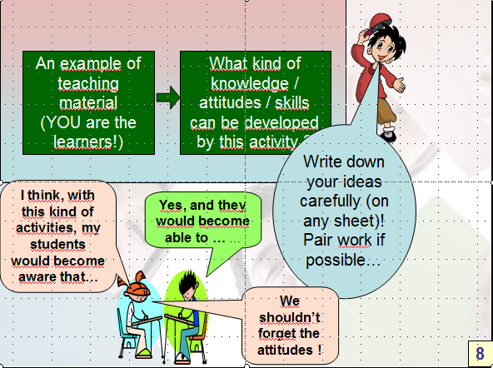
Professor PhD Uhu
Young man, I know exactly what I have to do! …
Knowledge, attitudes, skills…
… Hm … what was it again? … ? …
… Yes… Of course ! …
OK!
This is what we now call:
FREPA – Competences and resources
As they use the same fundamental principle – like I said – all pluralistic approaches can lead students to develop similar abilities.
That is the reason why researchers have thought it possible to produce a single document which lists knowledge, attitudes and skills which may be developed through using pluralistic approaches.
Yes, you’re right,
this is what Carapito
asked us to imagine
after the first activity!
67

Slide 68
An example of teaching material – YOU are the learners!
An example of a teaching material
YOU are the learners!
What kind of knowledge / attitudes / skills can be developed by this activity?
FREPA – Competences and resources
I presume you would like now to discover the content of FREPA - Competences and resources!
As you now know, this activity relates to one pluralistic approach (Awakening to languages). Ideally, your findings correspond to descriptors in the Competences and resources proposed by the FREPA!
I propose that you do it in an active manner, starting from what you have found as I asked you to imagine which knowledge, attitudes and skills can be developed with the first activity you did.
68

Slide 69
An example of teaching material – YOU are the learners!
An example of a teaching material
YOU are the learners!
What kind of knowledge / attitudes / skills can be developed by this activity?
FREPA – Competences and resources
Make use of the document
“My findings and FREPA”
(Download)
Your findings?
………………….
………………….
………………….
………………….
I propose that you do it in an active manner, starting from what you have found as I asked you to imagine which knowledge, attitudes and skills can be developed with the first activity you did.
69

Slide 70
An example of teaching material – YOU are the learners!
An example of a teaching material
YOU are the learners!
What kind of knowledge / attitudes / skills can be developed by this activity?
FREPA – Competences and resources
Your findings?
………………….
………………….
………………….
………………….
Finished the task ?
Finished the task ?
Finished the task ?
Yes!
Please finish it before going on
Not yet…
(Click one)
70

Slide 71
An example of teaching material – YOU are the learners!
An example of a teaching material
YOU are the learners!
What kind of knowledge / attitudes / skills can be developed by this activity?
FREPA – Competences and resources
But also for curriculum/
programme designers and textbook writers!
They also need an organised list of possible objectives!
I find it very interesting for teachers! They can specify their teaching objectives, find further objectives…
Of course!
71

Slide 72
An example of teaching material – YOU are the learners!
An example of a teaching material
YOU are the learners!
What kind of knowledge / attitudes / skills can be developed by this activity?
FREPA – Competences and resources
But why “Competences” and “Resources”? Isn’t it the same?
It is under the tab Key ideas!
No!
Please, look at the explanation given on the FREPA Website…
72

Slide 73
An example of teaching material – YOU are the learners!
An example of a teaching material
YOU are the learners!
What kind of knowledge / attitudes / skills can be developed by this activity?
FREPA – Competences and resources
Another question:
Can we find those descriptors on paper, or print them?
Another question:
Can we find those descriptors on paper, or print them?
This time under the tab Components!
Yes! They are in the brochure FREPA – Competences and resources, also on the FREPA Website…
73

Slide 74
And the FREPA Website also presents the descriptors of resources across the curriculum!
It reproduces each descriptor with an (approximate) indication of its relevance at different phases of the curriculum.
Direct access
It can also be found under the tab Components!
74

Slide 75
Yes!
But what can we do, once we have discovered resources we find relevant for our learners among the FREPA descriptors?
We need teaching materials which enable us to help them to develop these interesting resources!
Be patient!
You should first visit the database of Online teaching materials!
Very good indeed!?
75

Slide 76
1- First find an answer to the question Which teaching materials are available?
(Please, come back here after having done this!)
(It can also be found under the tab Teaching materials!)
76

Slide 77
1- First find an answer to the question Which teaching materials are available?
(Please, come back here after having done this!)
2- … Ready ? You can now view the online database
You will find a search interface.
There are two ways of using this:
- A guided tour of this interface
- You try to discover it by yourself.
(This also can be found under the tab Teaching materials!)
77

Slide 78
Finished discovering the search interface?
Please finish it before proceeding!
Yes!
Not yet…
(Click one)
78

Slide 79
- You can find materials by choosing the descriptors as criteria.
- You can add further search criteria:
Level of learners
Language of instruction
Thematic domains
Particular pluralistic
approach
Just to be sure…
You should have discovered that:
- Each material is referred to some FREPA resource descriptors which indicate which knowledge, attitudes and skills it may help to develop.
- You can also use these “further criteria”, without starting from the FREPA descriptors.
But the more criteria you combine, the less materials you find!
79

Slide 80
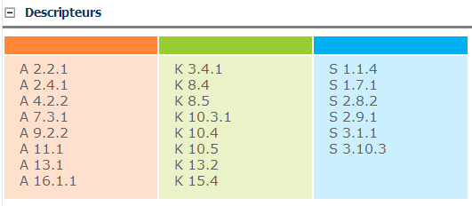

You may also have noticed that the choice of descriptors is limited to three steps:
For example: you can search for S 3.1, but not for S 3.1.1.
This is to avoid too narrow a selection of descriptors which might lead to disappointing results (too few or no materials)
Click here to continue to the next (and final)
part!
But you may well find
S 3.1.1. attributed to the teaching materials you have selected under S 3.1!
S 3.1.1
?
80
80

Slide 81
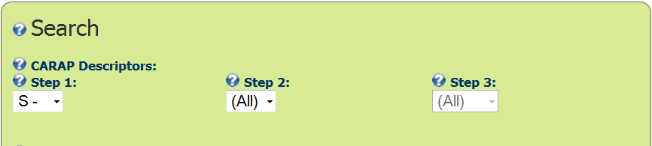
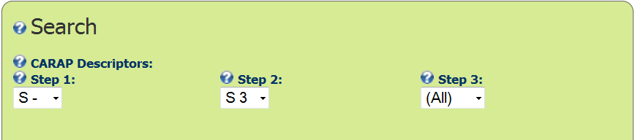


You select
S-
… then S 3
… then S 3.1
Do it at the same time on the website!
Let’s imagine you are interested in the descriptor
S 3.1 Can apply procedures for making comparisons
…
For children by the end of primary school.
Don’t forget the school level !
81

Slide 82
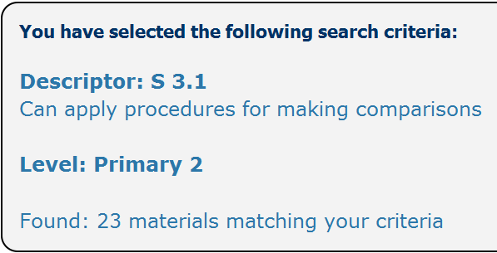
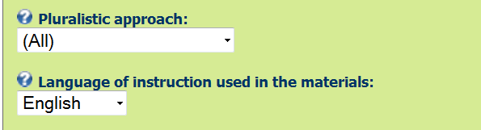
With each step have a look at the materials which appear under the interface !
You can therefore eventually add an other criterium!
For example materials written in English.
The interface indicates that there exists 23 matérials which match your choices.
More exactly: They were 23 as we have worked out this Powerpoint!
For sure, there will be more of them when you use it!
82

Slide 83
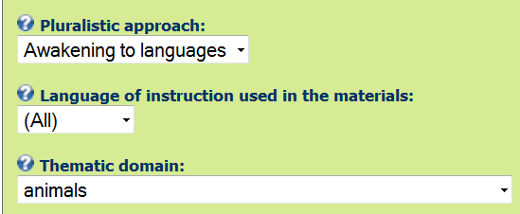
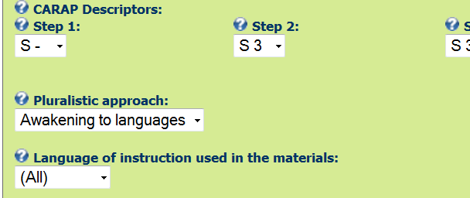
You may also ask for one specific pluralistic approach…
For example only materials corresponding to Awakening to languages…
And why not a thematic domain, like animals ?
83

Slide 84

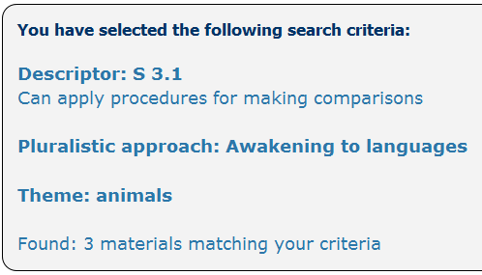
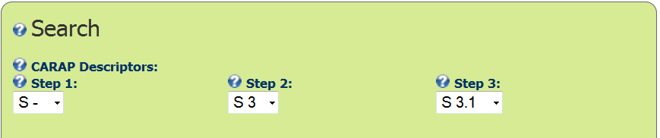
As you could see, when you add a criterium, you get of course less selected materials.
But it may occur that you find S 3.1.1. in a list of descriptors attributed to teaching materials you have selected with S 3.1 !
In order to avoid that users get too few selected materials, we also decided to limit the choice of descriptors to three elements : you can ask for S 3.1, but not for S 3.1.1.
S 3.1.1
?
84

Slide 85
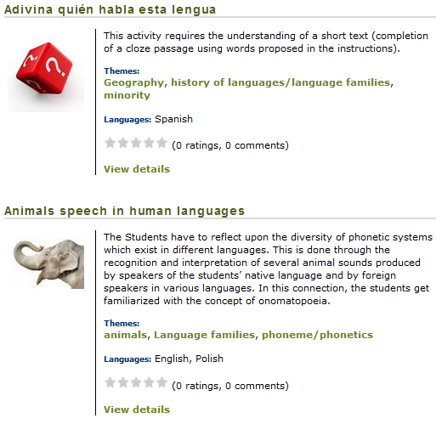
You have also seen that there is under the selection interface a list of teaching materials which are presented very briefly.
If you click on “View details” for the card you are interested in…
85

Slide 86
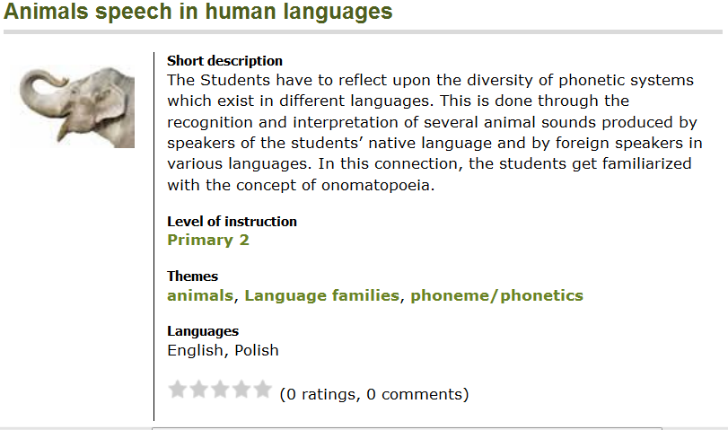
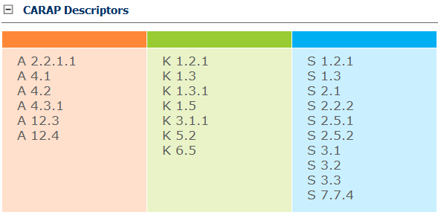
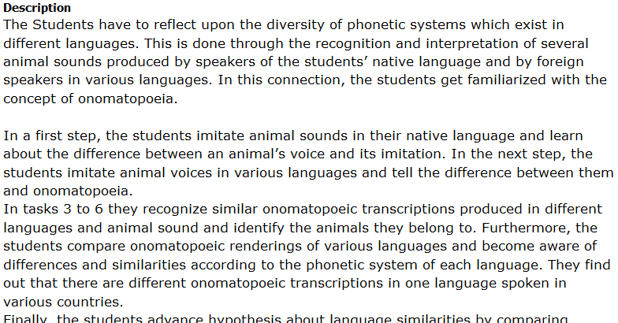

… a more detailed card will appear, with many indications, such as….
The resources which can in our opinion be developed by this material.
If you cannot open it, copy this link: http://carap.ecml.at/LinkClick.aspx?fileticket=4pirTyFFRsE%3d&tabid=3063&language=fr-FR
A more detailed summary.
The type of approach and of materials used.
The origin of the material.
And a link for downloading. Click !
86
Notes:
86

Slide 87
From teaching material to descriptors
An example of teaching material – YOU are the learners!
An example of a teaching material
YOU are the learners!
What kind of knowledge / attitudes / skills can be developed by this activity?
FREPA – Competences and Resources
If I have understood correctly …
during this presentation, we went first from an example of a teaching material to the FREPA descriptors…
87

Slide 88

From teaching material to descriptors
An example of teaching material – YOU are the learners!
An example of a teaching material
YOU are the learners!
What kind of knowledge / attitudes / skills can be developed by this activity ?
FREPA – Competences and Resources
You are right!
Other Teaching materials…
Search in database Online teaching materials
From descriptors to teaching materials
… and then back from FREPA descriptors to teaching materials!
88

Slide 89
This is the end of our presentation.
We all hope you have enjoyed it!
To know more about Pluralistic approaches and FREPA :
see the other modules of
our Training kit
read
  FREPA – Competences
  and resources
  FREPA – an
  introduction for users
see your Country page
(if it already exists)
89

Slide 90

dank u wel
gmadlobth
obrigado
спасибо
tanemirt
Ευχαριστώ
enkosi
kiitos
misaotra
If you think it is useful for you, in the next slides you can find a chart illustrating the main steps of the module.
You will also find the references of the publications we have mentioned.
90
Notes:
90

Slide 91

Example of teaching material
Participants in the role of learners!
Reflect about :
1
1
1
Which procedures did you use? (Answer : links between languages)
What kind of knowledge / attitudes / skills can be developed by this material?
1a
1a
1a
1b
1b
Click on the step you want to see again!
Part 1a is in the teaching material “Some languages of Europe … and elsewhere”, not in the slides of the module.

Slide 92
Example of teaching material
Participants in the role of learners!
Reflect about :
1
1
1
Which procedures did you use? (Answer : links between languages)
What kind of knowledge / attitudes / skills can be developed by this material?
1a
1a
1a
1b
1b

Slide 93
Example of teaching material
Participants in the role of learners!
Reflect about :
1
1
1
Which procedures did you use? (Answer : links between languages)
What kind of knowledge / attitudes / skills can be developed by this material?
1a
1a
1a
1b
1b
Definition : Plurilin-gual and pluricultural Competence
Definition : Pluralistic Approaches
Presentation of the 4 Plur. Appr. With examples
2
= didactic approaches which use teaching / learning activities involving several (i.e. more than one) varieties of languages or cultures
Awakening to languages, Intercomprehension between related languages, intercultural approach, integrated didactic approach to different languages studied.
93

Slide 94
Example of a teaching material
Participants in the role of learners!
Reflect on :
1
1
1
Which procedures did they use ? (Answer : links between languages)
What kind of knowledge / attitudes / skills can be developed by this material?
1a
1a
1a
1b
1b
Definition : Plurilin-gual and pluricultural Competence
Definition : Pluralistic Approaches
Presentation of the 4 Plur. Appr. With examples
2

Slide 95
Example of a teaching material
Participants in the role of learners!
Reflect on :
1
1
1
Which procedures did they use ? (Answer : links between languages)
What kind of knowledge / attitudes / skills can be developed by this material?
1a
1a
1a
1b
1b
Definition : Plurilin-gual and pluricultural Competence
Definition : Pluralistic Approaches
Presentation of the 4 Plur. Appr. With examples
2
Knowledge, attitudes, skills
Bye!
FREPA – Competences and Resources
Search in Database Online teaching materials
3
95

Slide 96
References
- Beacco, J.-C. & Byram, M. (2007). From linguistic diversity to plurilingual education: Guide for the development of language education policies in Europe. Strasbourg, Council of Europe. http://www.coe.int/t/dg4/linguistic/Source/Guide_Main_Beacco2007_EN.doc.
- Beacco, J.-C. et al. (2010). Guide for the development and implementation of curricula for plurilingual and intercultural education. Strasbourg, Council of Europe. http://www.coe.int/t/dg4/linguistic/ListDocs_Geneva2010.asp
- Herdina, P. & Jessner, U. (2002) . A Dynamic Model of Multilingualism. Perspectives of Change in Psycholinguistics. Clevedon, Multilingual Matters
Professor PhD Uhu

